Slide 1

Psychiatric Emergencies: Suicide and Agitation
Contributors
Marissa Beal, DO
Lauren M. Osborne, MD

Slide 2
Disclosures/Disclaimers/Acknowledgments
Dr. Beal and Dr. Osborne report no financial conflicts of interest

Slide 3
How to use this material
Review slides individually or as a self study group.
For questions, go to normal view and read the notes.

Slide 4
Learning Objectives:
Identify prevalence of suicide in postpartum patients
Describe risk factors for suicide
Learn how to assess a patient’s acute suicide risk
Identify appropriate level of care for a patient
Learn how to manage agitation

Slide 5
Outline:
Introduction
Epidemiology: rates/incidence, risk factors and screening
Clinical Features: clinical presentation and course/prognosis
Assessment
Treatment: psychopharmacology and non-pharmacology
Key Clinical Points
Conclusion

Slide 6
Introduction
Suicide is a leading cause of death for postpartum patients
Screening for postpartum depression may uncover suicidal ideation
It is vital to evaluate further and determine most appropriate level of care
Notes:
Commonly used screening scales, such as the Edinburgh and the PHQ9, do include questions about suicidality

Slide 7
Roadmap to Evaluate Acute Risk
Emergent
(violent, deregulated, imminently unsafe)
Acute suicidality – plan/intent/means, unable to contract for safety
Acute withdrawal with alteration in mental status
Homicidally or other aggressive behavior against others
Agitated/Aggressive/Non-redirectable (e.g. Manic/Psychotic/Intoxicated)
Postpartum Psychosis
Acute alteration in mental status
Urgent
(non-violent, non-deregulated with potential for decompensation)
Low lethality suicide attempts without current plan
Alcohol or substance abuse without delirium or altered sensorium
Pregnant patient requesting detoxification
Depression or Anxiety but no suicidal ideation/intent/plan
Medication management
Outpatient consultation
Non-Urgent
(Courtesy of Neda Hudepohl, MD)
Notes:
This is a roadmap to evaluating overall psychiatric risk–note that acute suicidality with plan/intent/means constitutes a psychiatric emergency

Slide 8
Epidemiology
Suicide is one of the leading causes of maternal mortality
Suicide prevalence ranges from approximately 1 to 5 per 100,000 live births
Most common at 9-12 months postpartum
Infanticide is approximately 2 to 7 per 100,000 live births
Prior to suicide, many patients (45%) have contact with a primary care provider
Notes:
Admon, L. K., Dalton, V. K., Kolenic, G. E., Ettner, S. L., Tilea, A., Haffajee, R. L., ... & Zivin, K. (2021). Trends in suicidality 1 year before and after birth among commercially insured childbearing individuals in the United States, 2006-2017. JAMA psychiatry, 78(2), 171-176.
Margerison, C. E., Roberts, M. H., Gemmill, A., & Goldman-Mellor, S. (2022). Pregnancy-Associated Deaths Due to Drugs, Suicide, and Homicide in the United States, 2010–2019. Obstetrics & Gynecology, 10-1097.

Slide 9
Perinatal suicide risk factors
Postpartum psychosis
Major mental illness, especially bipolar disorder
Intent or plan
Access to lethal means
Personal history of suicide attempts
Family history of completed suicide
Intimate partner violence
Stillbirth
Poor sleep
Self-neglect
Lack of interest in child
Notes:
Note: postpartum psychosis, which is thought to be a variant of bipolar disorder, carries a risk of both suicide and infanticide

Slide 10
Screening
Edinburgh Postnatal Depression Score
(Question 10: “The thought of harming myself has occurred to me”)
PHQ-9
(Question 9: “Thoughts you would be better off dead or of hurting yourself in some way”)
Mood Disorder Questionnaire - screen for bipolar disorder
Columbia Suicide Severity Rating Scale
Screen for suicide at every visit in first year postpartum – while many women come only for their 6-week visit, others may present for routine gyn or primary care visits later in that year and should be screened
Notes:
Practices will often rely on the depression screeners for initial screening, then do something like the CSSRS only for those with a positive response on suicide questin

Slide 11
Case Presentation:
Lucy B. is a 24-year-old woman who presents to her OB for her 2 week postpartum visit
She breaks down and starts crying, noting that she is feeling down and unable to laugh and enjoy herself as much as she used to.
You screen her for depression; her total score on the EPDS is just 11, but she answers “yes quite often” regarding thoughts of harming herself.
Next steps….
Ask follow-up questions to assess her acute risk
Notes:
You can pause here to ask what questions the provider may ask. Important to ask learners to come up with these questions before feeding them the answers.

Slide 12
Suicide Risk Assessment
Clarify question 10 on Edinburgh, clarify timing of suicidal thoughts (current vs past)
Identify active (I want to overdose on pills) vs. passive (I would like to go to sleep and never wake up)
Identify plan: Do you have thoughts of a specific plan, timing, place or method?
Identify means: Do you have access to guns, pills, etc.?
Identify intent: Do you plan to follow through with this? What reasons do you have to be alive? How close have you come to following through on your plan?
Identify history: Have you tried to commit suicide in the past? Have your family members committed suicide in the past?
Identify deterrents: Are you religious? What are reasons to be alive?
Notes:
Of note, in contrast to popular perception, asking about suicide does NOT “make” someone suicidal and in fact may lower suicide risk. For example: https://pubmed.ncbi.nlm.nih.gov/24998511/

Slide 13
Suicide Risk Assessment
Passive suicidal ideation -> assess time course, acute vs. chronic, is patient engaged with mental health provider? Consider follow-up with mental health provider or further increased follow-up if not engaged in treatment
Active suicidal ideation -> will require further psychiatric evaluation, send to ER, potentially will need psychiatric hospitalization
If unsure -> obtain further collateral from family, err on the side of obtaining a psychiatric evaluation
Rules surrounding Involuntary evaluation vary by state, but usually appropriate if patient is at imminent risk of self-harm/suicide

Slide 14
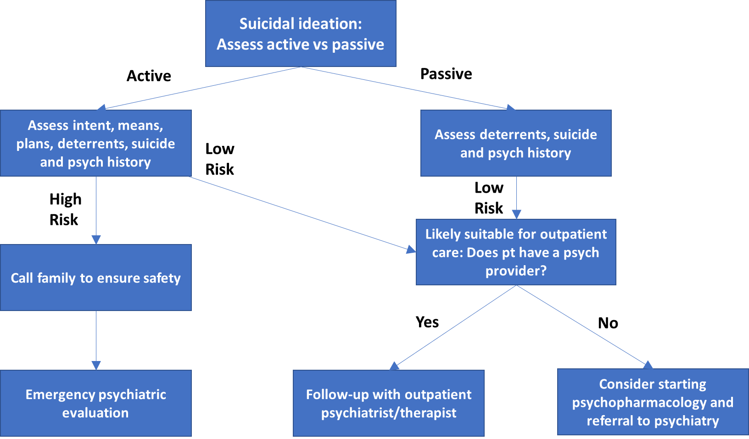
Suicide Risk Assessment
Notes:
The most important question to answer is whether this patient can safely leave your office. Someone with chronic passive suicidal ideation with no plan, means, or intent may seem scary to you but does not require urgent intervention.

Slide 15
Assessment
Screen for signs and symptoms of mania and psychosis
How are you sleeping? Do you feel like you need less sleep these days?
Are your thoughts racing?
Are you talking faster than normal?
Are you hearing or seeing things?
Are you worried people are after you or out to get you?
Are you having thoughts of hurting your baby?
Speak with family to assess for changes in behavior
Notes:
These are very important – because someone who is manic or psychotic may be subject to rapid change of symptoms, and may be guarded about revealing suicidal thougohts.

Slide 16
Assessment: Clinical features of mania
Elevated or irritable mood
Increased self esteem or grandiosity
Decreased need for sleep
Rapid speech
Racing thoughts or flight of ideas
Distractible
Increased goal directed activity (such as cleaning, cooking)
Increased dangerous behavior (spending lots of money, using substances, high-risk sexual behaviors)
Mania | Hypomania
lasts 1 week or more | lasts at least 4 days
psychosis | no psychosis
impairs functioning or requires hospitalization | doesn’t impair functioning

Slide 17
Assessment: Clinical features of psychosis
Psychosis:
delusions (fixed false beliefs)
paranoia
hallucinations (hearing or seeing things that are not there)
disorganized thoughts or behavior
Mood symptoms with psychosis:
mania with psychotic features
depression with psychotic features
Postpartum psychosis:
delirium-like presentation
insomnia
delusions regarding the baby

Slide 18
Assessment: Emergency evaluation protocol
Identify working diagnosis: suicidal or homicidal ideation, psychosis, mania, delirium
Trigger emergency psych evaluation, including transportation
Consider state-specific regulations regarding involuntary emergency psych evaluation; your team should know what these regulations are
Collaborate with psychiatric team and family and identify roles within the perinatal and psychiatric team in relation to treatment and follow-up care
Identify resources, support staff, and treatment needed at each step
This protocol should be in place PRIOR to an emergency!
Notes:
Kendig, S., Keats, J. P., Hoffman, M. C., Kay, L. B., Miller, E. S., Simas, T. A. M., ... & Lemieux, L. A. (2017). Consensus bundle on maternal mental health: perinatal depression and anxiety. Journal of Obstetric, Gynecologic & Neonatal Nursing, 46(2), 272-281.

Slide 19
Treatment
Depending on severity of suicidal ideation, including plan, intent, means, may require psychiatric hospitalization
Medication management for underlying mood disorder
Depression - SSRI
Screen for bipolar disorder
Bipolar disorder - mood stabilizer or antipsychotic
Schizophrenia/schizoaffective disorder - antipsychotic
Psychotherapy
ECT
Notes:
For your purposes as an OB, it matters less what exactly the psychiatric diagnosis is and more what immediate action you need to take. Does the patient need hospitalization? Emergency room?

Slide 20
Case continued:
Upon further questioning, Lucy B. endorses active suicidal ideation as well as
decreased need for sleep
delusions
thoughts of harming her baby
She becomes increasingly agitated about waiting for further evaluation and starts banging on the door to leave
She is yelling and becomes physically aggressive towards staff
Notes:
Note: now, in addition to evaluating for risk of suicide, the patient has now started to become agitated, so managing that agitation is also important. Here, you start to wonder if the agitation may be due to underlying hypomania or mania (given the decreased need for sleep, delusions, and thoughts of harming her baby). What’s important to note is that this has rapidly escalated into an emergency situation.

Slide 21
Identifying agitation
Agitation - increased arousal, uncooperative or combative behavior, physical restlessness, increased verbal and motor activity, and extreme irritability
Can range from mild to severe
Various etiologies
Psychiatric illness
Medical illness
Withdrawal or intoxication
Delirium
Aggression - behaviors that have the potential to harm another person, regardless of intent or whether harm actually occurs
Notes:
Agitation and aggression are not psychiatric disorders in themselves, but rather can be manifestations of many different disorders, including substance use in addition to Axis 1 psychiatric disorders and delirium. It’s important to know both how to deal with the current behavioral disturbance as well as how to get the help you need to determine the underlying problem/
Hutner, L. A., Catapano, L. A., Nagle-Yang, S. M., Williams, K. E., & Osborne, L. M. (Eds.). (2021). Textbook of Women's Reproductive Mental Health. American Psychiatric Pub.

Slide 22
Identifying bias in agitation management
Utilize a trauma informed care framework when managing patients with agitation
Racial bias may increase perceived dangerousness in patients with psychiatric comorbidities
Stressful situations (such as an agitated patient) may exacerbate implicit bias
Identify potential biases when assessing for dangerousness
Attempt verbal de-escalation for all patients
Notes:
Spector, R. (2001). Is there racial bias in clinicians' perceptions of the dangerousness of psychiatric patients? A review of the literature. Journal of mental health, 10(1), 5-15.
Agboola, I. K., Coupet, E., & Wong, A. H. (2021). “The Coats That We Can Take Off and the Ones We Can’t”: The Role of Trauma-Informed Care on Race and Bias During Agitation in the Emergency Department. Annals of emergency medicine, 77(5), 493-498.

Slide 23
Handling Agitation
Verbal de-escalation
Consider need for medication according to patient’s symptoms, as you would with any other patient
Suit the medication to the symptoms – why is the patient agitated?
High-potency typical antipsychotics have extensive safety data and work quickly
Good safety data now on second-generation as well
Remember that HIGHER doses may be needed in pregnancy
When possible, minimize exposures to the fetus – but remember that frank psychosis and agitation are ALSO an exposure
Notes:
Spector, R. (2001). Is there racial bias in clinicians' perceptions of the dangerousness of psychiatric patients? A review of the literature. Journal of mental health, 10(1), 5-15.
Agboola, I. K., Coupet, E., & Wong, A. H. (2021). “The Coats That We Can Take Off and the Ones We Can’t”: The Role of Trauma-Informed Care on Race and Bias During Agitation in the Emergency Department. Annals of emergency medicine, 77(5), 493-498.

Slide 24

Physical restraints
Avoid when possible
If restraints are necessary-
NEVER use 4-point restraints when a pregnant patient is on their back or right side
Inferior vena cava syndrome
Turn body part way to left
Frequent monitoring

Slide 25
Physical restraints
Avoid when possible
If restraints are necessary-
NEVER use 4-point restraints when a pregnant patient is on their back or right side
Inferior vena cava syndrome
Turn body part way to left
Frequent monitoring
Notes:
Agitation and aggression are not psychiatric disorders in themselves, but rather can be manifestations of many different disorders, including substance use in addition to Axis 1 psychiatric disorders and delirium. It’s important to know both how to deal with the current behavioral disturbance as well as how to get the help you need to determine the underlying problem/
Hutner, L. A., Catapano, L. A., Nagle-Yang, S. M., Williams, K. E., & Osborne, L. M. (Eds.). (2021). Textbook of Women's Reproductive Mental Health. American Psychiatric Pub.

Slide 26
Key Clinical Points
Identify risk factors for suicide
Screen patients for depression and suicide to appropriately triage level of care
Rule out psychosis and mania
Manage agitation with psychiatric medications if indicated
Use restraints safely when necessary

Slide 27
Reflection questions
Has a patient reported suicidal ideation to you in the clinic? If so, how did you screen them further and manage this in the outpatient setting?
Does your clinic have an emergency referral protocol in the case of an agitated or suicidal patient?
Describe a scenario where you needed to de-escalate an agitated patient. What worked well in that scenario and what could have gone better?

Slide 28
References
Kendig, S., Keats, J. P., Hoffman, M. C., Kay, L. B., Miller, E. S., Simas, T. A. M., ... & Lemieux, L. A. (2017). Consensus bundle on maternal mental health: perinatal depression and anxiety. Journal of Obstetric, Gynecologic & Neonatal Nursing, 46(2), 272-281.
McDowell, A. K., Lineberry, T. W., & Bostwick, J. M. (2011, August). Practical suicide-risk management for the busy primary care physician. In Mayo Clinic Proceedings (Vol. 86, No. 8, pp. 792-800). Elsevier.
Stacy, M., Kremer, M., & Schulkin, J. (2022). Suicide Among Women and the Role of Women’s Health Care Providers. Obstetrical & Gynecological Survey, 77(5), 293-301.
Rodriguez-Cabezas L, Clark C. Psychiatric Emergencies in Pregnancy and Postpartum. Clinical Obstetrics & Gynecology 2018; 61(3): 615-627.
Wilson MP, Nordstrom K, Shah AA, Vike GM. Psychiatric Emergencies in Pregnant Women. Emerg Med Clin N Am 33 (2015) 841–851

Slide 29
Resources
Postpartum Support International
MGH Women’s Mental Health Center:
www.womensmentalhealth.org
LactMed
Mothertobaby.org
National Suicide Prevention Hotline: 1-800-273-8255
www.suicidepreventionlifeline.org

