Slide 1
Clinical Approach to the Treatment of the Peripartum Patient
Julia N Riddle, MD
Emily S Miller, MD, MPH
Lucy Hutner, MD
Lauren M Osborne, MD
Amanda Yeaton-Massey, MD, PMH-C
Marika Toscano, MD

Slide 2
Disclosures/Disclaimers/Acknowledgments
Julia N. Riddle, MD - none
Emily S Miller, MD, MPH - none
Lucy Hutner, MD - Cofounder and Chief Medical Advisor for Phoebe, Inc.
Lauren M Osborne, MD - none
Amanda Yeaton-Massey, MD, PMH-C - none
Marika Toscano, MD - none

Slide 3
How to use this material
Review slides individually or as a self study group.
For questions, go to normal view and read the notes.

Slide 4
Learning Objectives:
Develop an approach to psychiatric assessment in the perinatal period.
Discuss risks associated with untreated depression in pregnancy and postpartum.
Practice risk-risk discussions in pregnancy with a focus on depression management.
Appreciate unique factors in the management of perinatal depression in the context of risks of both medications and untreated psychiatric illness.

Slide 5
Outline:
Introduction
Screening: recommendations for type and timing
Case example following perinatal depression to illustrate clinical management key points
Counseling: risk-risk paradigm
Treatment: key clinical considerations
Cases
Notes:
We will focus some on perinatal depression - as this is a digestible way to emphasize some concepts about diagnostic criteria for perinatal mental health and differential diagnosis.

Slide 6
Perinatal Depression: Definitions
Criteria for the DSM-5 specifier “with peripartum onset”:
“Current or most recent major depressive episode had onset during pregnancy or in the first 4 weeks postpartum”
Challenges:
Some symptoms overlap with “normal” pregnancy include fatigue, changes in appetite, poor sleep.
Conflates antenatal and postpartum depression - which may have divergent pathophysiologies
Does not acknowledge later onset perinatal depression
Notes:
The diagnosis, from the DSM, is MDD with peripartum onset.
This refers to current or most recent major depressive episode had onset during pregnancy or in the first 4 weeks postpartum
There are similar issues with other mental health conditions - acknowledging that the onset can be during or after pregnancy is an important first step in case finding.
Important to remember that a positive screen screen is not a diagnosis. Some symptoms overlap - important to remember to assess whether anhedonia or depressed mood are present
While research is ongoing, there are some that hypothesize antenatal and postpartum depression have different underlying pathophysiologies.
Also important to know that many in the field are advocating for this to be extended beyond 4 weeks to 12 months, given the ongoing exposures and risks for MDD

Slide 7
Differential Diagnosis
Most commonly, depression and anxiety disorders, but also consider:
Bipolar disorder
Psychotic disorders
Trauma and stressor-related disorders
Obsessive compulsive disorder
Eating disorders
Substance use disorders
Notes:
Refer to MDD lecture for more details

Slide 8
Caveat
Lecture will focus on pharmacotherapy
Psychotherapy should be 1st line treatment for all birthing people
  Psychotherapy is synergistic with pharmacotherapy
  Often not accessible or acceptable, so medications are only practical treatment option
  Pharmacotherapy (+psychotherapy) should be recommended for moderate or severe depression

Slide 9
Psychotherapy: practical tips
How to answer common questions about therapy:
What do psychotherapists (“therapists”) do?
“Behavioral health counselors offer mental health counseling and can help with issues like depression, anxiety, stress, relationship issues, parenting, trauma, grief and loss, concerns during and after pregnancy, sexual issues, and chronic pain.”
Why do I need psychotherapy? Can’t I just take a medication?
“Medications can’t do all the work to fix the root causes of your [mood or anxiety disorder]. You also need to work to change your thought patterns, relationship styles, sleep and, stressful triggers. Problem-solving therapy with the help of a professional can help you break these overwhelming issues into bite-sized, manageable pieces.”
What can I expect when I go to therapy?
“At your first visit, you will be asked about your medical and mental health history, current things going on in your life, and your goals for therapy. At follow up visits, your therapist will check in about how things are going and help you progress towards your goals of feeling better.”

Slide 10

Psychotherapy: practical tips
How to search for nearby mental health providers:
Psychology today (https://therapists.psychologytoday.com/rms/)
  Filter by women’s health AND insurance AND location
American Psychological Association (https://locator.apa.org)
Postpartum support international (www.postpartum.net)
  Online support groups
  Support hotline (1-800-944-4773)
  International therapist locator (https://postpartum.net/get-help/providerdirectory)
Notes:
Three great resources are listed above

Slide 11
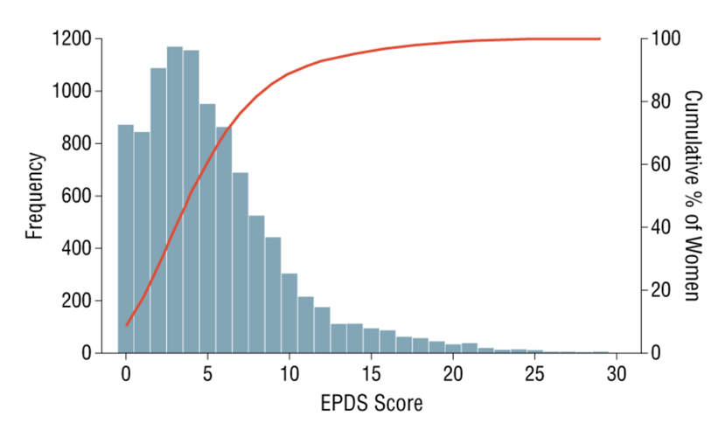
Epidemiology
Perinatal mental illness is the most common complication of pregnancy
Affects 1 in every 5-7 birthing people
20% will have symptoms after the 1st year postpartum
13% will continue to have symptoms after the 2nd year postpartum
Can be either a new presentation or relapse/ exacerbation of existing mental illness
Wisner et al., 2013, JAMA Psychiatry.
Notes:
This histogram depicts the number of women with each EDPS score in a large prospective cohort of 10,000 postpartum women in Pittsburgh who were screened for perinatal depression using the EPDS
Of the 10,000 women screened:
7.0% screened positive for major depression. This is not an uncommon finding.
Wisner, K. L., Sit, D. K., McShea, M. C., Rizzo, D. M., Zoretich, R. A., Hughes, C. L., ... & Hanusa, B. H. (2013). Onset timing, thoughts of self-harm, and diagnoses in postpartum women with screen-positive depression findings. JAMA psychiatry, 70(5), 490-498.

Slide 12
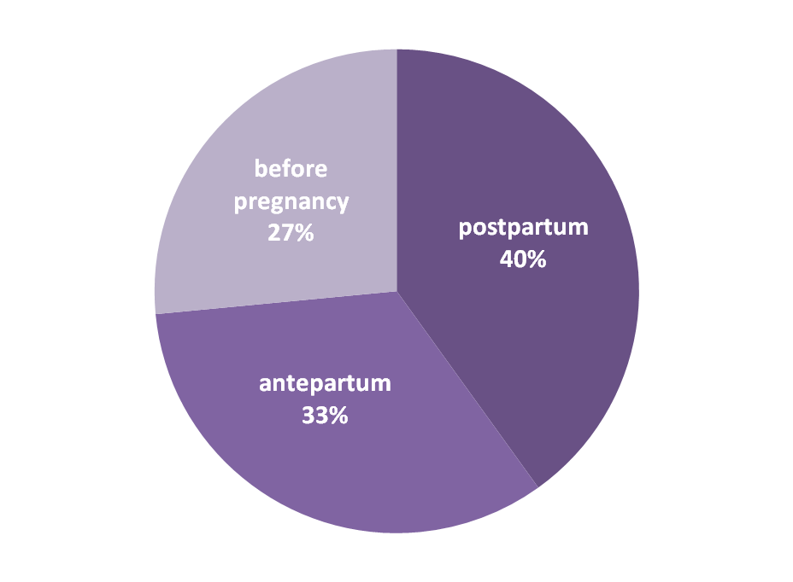
Timing of Onset of Depressive Symptoms
(in 10,000 women screened in Pittsburgh)
Wisner et al., 2013, JAMA Psychiatry.
Notes:
This is data from that same cohort of the 10K women in Pittsburgh screened for perinatal depression. For women who screened positive, when asked about timing of onset of symptoms, 40% of women reported that their symptoms began within the 3 months postpartum. Given the short time duration, this remains the time of highest day by day incidence of depressive symptoms.
But 33% of women developed depressive symptoms during pregnancy and 27% reported symptoms starting even before pregnancy began. This means that if we were to screen only postpartum, we may leave 60% of women with depression un-identified and un-treated during their pregnancy.
This finding led to the change in nomenclature to reflect perinatal depression - not just postpartum depression.
Due to this and other similar findings, ACOG “strongly encourages” screening both antenatally and postpartum. We would recommend screening each trimester during pregnancy and again postpartum as an ideal. A reasonable alternative would be to screen at least twice during pregnancy --- once at the first prenatal visit and once again in the 3rd trimester --- and again postpartum.
Wisner, K. L., Sit, D. K., McShea, M. C., Rizzo, D. M., Zoretich, R. A., Hughes, C. L., ... & Hanusa, B. H. (2013). Onset timing, thoughts of self-harm, and diagnoses in postpartum women with screen-positive depression findings. JAMA psychiatry, 70(5), 490-498.

Slide 13

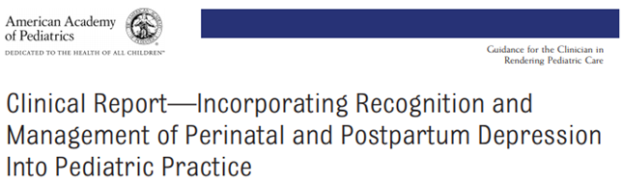


Screening
Notes:
Multiple professional societies, including ACOG, AAP, SMFM and USPSTF have recommended screening for perinatal depression both during pregnancy and postpartum. Current ACOG guidelines call for first prenatal visit, another time point in pregnancy, and 6-week postpartum visit. This should be considered a minimum. Many OBs find it difficult to fit in time for screening, but crucial to do so – remember that mental health conditions are the leading cause of pregnancy-related death.

Slide 14
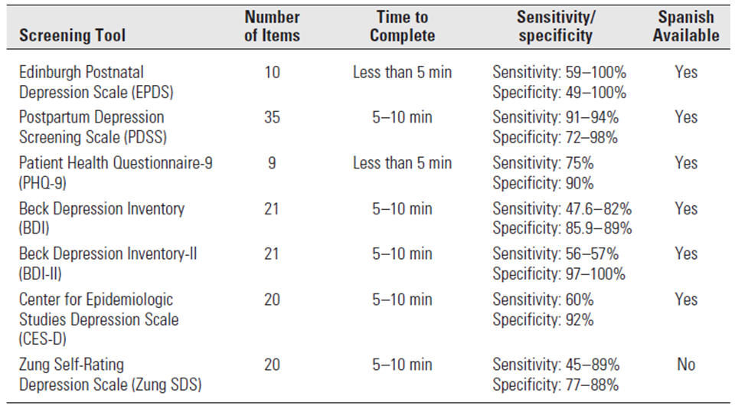
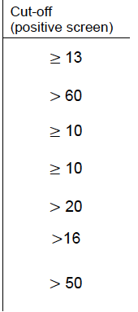
Screening
ACOG Committee Opinion 453
Notes:
Conway, C. A. (2010). ACOG encourages screening for depression during and after pregnancy. Health Law Perspectives. February.
ACOG does not endorse a specific perinatal depression screening tool, but gives guideliens on timing as in previous slide. The USPSTF recommends screening at least once during pregnancy and once postpartum. Because symptoms can arise at any time, this may be inadequate, and reproductive psychiatrists recommend screening once per trimester and at all postpartum visits.
Listed here are the 7 most commonly used scales. Each takes less than 10 minutes to complete, has good testing characteristics. Cut-off scores for positive screens are listed here.
The two most commonly used are the EPDS or the PHQ9. Both are freely available online, in multiple languages, are brief, and have reasonable test characteristics

Slide 15
Screening ≠ Diagnosis
All positive screens must be followed up with a diagnostic interview for further assessment
See module on “perinatal depression” for more information on recommended screening frequency in the perinatal period as well as how to respond to a positive screen
Notes:
Please don’t think screening is enough; screening is meant to prompt a conversation with the patient. If someone scores high because they are having a bad day, that’s not a reason to refer to psychiatry; have a conversation to find out if the person is actually having mental health symptoms.

Slide 16
Case: 27 y/o G1P0 at 18w3d
Past medical history: Asthma
Social history: Married, safe relationship
Allergies: None
Pregnancy: Planned, unremarkable, consistent prenatal care
EPDS: 17, no self-harm
Notes:
Let’s go through a case so you can see how to apply these principles.

Slide 17
Case: 27 y/o G1P0 at 18w3d
Psychiatric history:
One episode (~6 weeks) in college that she reports she was depressed and was treated with escitalopram 15 mg for a year and responded well
Sees a therapist twice a month since college to cope with stressors

Slide 18
Pause for a Mental Health History: Risk Stratify
Important questions to cover for background to risk stratify:
Have you ever felt like this before?
Have you ever had treatment? → if successful, use first!
Have you ever had a period of time where you felt the OPPOSITE of depression, had enormous energy and did not need to sleep for many days at a time? → risk for bipolar disorder, screen before antidepressant
Have you ever been psychiatrically hospitalized? → high risk, close follow-up
Have you ever been suicidal or attempted suicide? → high risk, close follow-up
Are you having suicidal thoughts now? → ER eval/inpatient
Notes:
Remember, screening is only a tool that prompts a conversation about mental health. Really important to figure out what is going on with the patient beyond the number on the scale. Before even beginning treatment discussion, the patient must be assessed for high acute risk of suicide/homicide/inability to care for self.

Slide 19
Case: 27 y/o G1P0 at 18w3d
Risk stratification:
No suicidal thought or passive death wishes
No history of suicide attempts
No psychiatric hospitalization
Assessed to be reliable in her report
Proceed to initiating treatment….
Notes:
Your main job as an OB is to 1) figure out if the patient is safe to leave your office and 2) direct her to appropriate treatment. You’re not expected to do it all alone!

Slide 20


Important clarifying questions
“Have you ever experienced the opposite of depression - feeling elated, not needing sleep for multiple days, talking fast, doing more risky things?”
“No, that’s never happened to me. I always need my sleep.”
“Yeah, I have definitely been struggling more with my mood for about four weeks.”
“The scale that we did with you indicates that you may be struggling with depression now. What do you think?”
Notes:
It can benefit the practitioner to take a moment to assess for any history of bipolar illness. Brief questions like this can help assess for the risks associated with standard depression treatment (ie. SSRIs triggering mania). Patient with a history of bipolar disorder require different treatment considerations and are at risk of postpartum psychosis. For more clinical detail, please see the section on Bipolar Affective Disorder and Postpartum Psychosis.

Slide 21
Important clarifying questions
“I’ve been doing yoga and walking. I have also started seeing my therapist more often.”
“What have you been trying on your own?”
“Is it OK during pregnancy?”
“What are your thoughts about medication?”
Notes:
The important question!

Slide 22
Risk-risk paradigm
There is no such thing as non-exposure
Counseling birthing people on whether to start or continue medication during pregnancy includes assessing the risks and benefits of the medication as well as the risks related to the illness.
Consider:
Medication = An Exposure
Illness = An Exposure
Undertreated Illness = Exposure to both (illness and meds)
...and try to decrease maternal exposures associated with adverse outcomes
Notes:
Depression is a medical complication of pregnancy. It means the pregnancy is high-risk, so there is no zero-risk choice to be made. We can never guarantee that anything in pregnancy is 100% safe – examples like breathing in air pollution, it certainly poses risk but we do it anyway

Slide 23

Risk-risk paradigm
X
No mental illness history (MDD)
No medication
MDD + medication
MDD
No medication
MDD + medication
Compare healthy women to ill women getting treatment
Compare women with untreated mental illness to treated mental illness
Notes:
Most of the literature compares healthy women without MDD (and no exposure to medication) to women with MDD on medications. They often ascribe any observed associations to the medications themselves
But this isn’t the clinical choice in front of us. This leads to risks of SSRIs being weighed more heavily than the benefits.
The proper design of studies is to compare untreated depression with treated depression - and when this is done, the findings often diverge from prior literature

Slide 24
Risk-risk paradigm
Risks of untreated perinatal depression:
Worse quality of life
More missed days of work
Suicide attempts/completion
Risk of substance use
Hypertensive disorders of pregnancy
Cesarean delivery
Preterm birth
Small for gestational age birth
Insecure attachment patterns
Developmental delays
Risks of medication (SSRI) use in pregnancy:
Congenital malformations
Preterm birth
Developmental delays
Neonatal adaptation syndrome
PPHN
Historically cited risks that have since been disproven with appropriate analysis
Notes:
Important to present counseling that balances the risks of untreated depression with the risks associated with medication.
Crossed out items have been previously considered but are now dis-proven with more appropriate analyses.
Presenting the paradigm in this manner allows providers and patients to realize the balance, for most birthing people, favors treatment with pharmacotherapy
For details on these specific risks, see MDD lecture

Slide 25
General principles:
Prescribing psychopharmacotherapy in pregnancy
Collaborate with the patient
Consider prior treatment trials
Set realistic expectations
Use side effect profile to your advantage
Ensure an adequate trial of medication before switching
Maximize one medication before adding another
Notes:
Collaborate with the patient:
use their prior medication history or family medication history to choose a medication
Set realistic expectations: there will be small incremental improvement in target symptoms, but not a dramatic instant improvement with initiation of medication. A symptom log can often help patients track improvement in their target symptoms.
Side effects will often occur prior to substantial benefit.
In some patients, a solution will not occur with the first medication prescribed
Inform that withdrawal symptoms may occur with abruption cessation of certain medications
Different psychoactive medications are associated with different side effect profiles:
Educate patients/provide anticipatory guidance on potential side effect profiles for medications prescribed
Explain that some early side effects are transient and bearable, others develop later or may be persistent and these will necessitate dose adjustment or medication change
Sedating medications may be more appropriate for patients with anxiety or sleep difficulties
An activating medication may be more appropriate for those with inertia symptoms
Ask about weight gain or sexual side effect concerns and factor the answer into medication choice
Ensure an adequate trial of medication before switching:
Make sure patient is taking at prescribed dose
An adequate trial is: at least 6 weeks, on at least ⅔ max dose - max dose

Slide 26
“Is it OK during pregnancy?”
“That’s a great question. Recurrence of depression is not uncommon during pregnancy, so let’s talk about our options.
It sounds like you did well with escitalopram in the past so I would be inclined to start with that.
The way that we think about treatment is as a risk-risk decision and discussion. We have to balance the risks of exposure to untreated mental illness against the risk of exposure to medicine.”

Slide 27
Risk-Risk Conversations
This is a structured conversation to provide patients with the information to understand that untreated illness IS an exposure
Brief discussion on risks as laid out on Slide 17
  “There is no option that is ‘no risk’ but SSRIs, like escitalopram, have reassuring safety data in pregnancy and we currently consider them low-risk”
May need a moment to further discuss neonatal adaptation syndrome
  See slide 33

Slide 28
Risk-Risk Conversations: Provider resources
Not sure of a medication’s safety profile in pregnancy or lactation?
Resources available:
  Reprotox (requires subscription)
  Lactmed (free)
  Psychiatry access programs (postpartum support international or state-funded)
  Slide 51 has additional resources

Slide 29
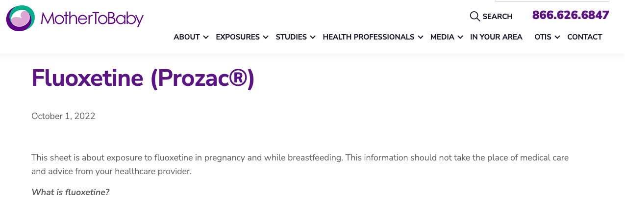
Risk-Risk Conversations: Patient resources
Can provide patient with additional take-home information
A useful resource are the Fact Sheets from Mother To Baby

Slide 30
Pharmacotherapy Initiation: Clinical Considerations
What is likely to work?
What are the medication side effects?
How much data do we have for each of our options?
What do the data tell us about each of our options?
What is the patient’s preference?
Notes:
When psychopharmacologic treatment is indicated during pregnancy, there are some “general tenets” to consider when formulating a treatment plan. To start, it is helpful to consider some questions which are not unique to the perinatal patient. After considering the patient’s comprehensive clinical presentation, consider what medications are likely to work for this patient and what are the common side effects for the various medications that might be clinically efficacious? It is critical to examine these two questions first as although a specific medication may be regarded as having the most reassuring risk profile in pregnancy or lactation, if that medication does not effectively treat the underlying illness, the patient is left with both an exposure to the prescribed medication as well as an exposure to the underlying illness. Furthermore, if a medication is potentially efficacious but is intolerable for the patient, she is unlikely to adhere to its use.
After these first two clinical considerations, the astute obstetrician will consider both the quality of the data regarding risk in pregnancy and lactation as well as the degree to which that data is reassuring or not. For example, a relatively new medication may have reassuring data, but this data may be limited to a handful of case reports. When comparing this new medication to an older medication that will likely have a more established safety profile, the quality of the information must be factored into the analysis.
Finally, it is important to inform the patient of the various treatment options along with the corresponding risks, benefits, alternatives and side effects and to make decisions in a collaborative fashion. If the patient is incapacitated by her mental illness, a substitute decision-make should be designated.
***pregnancy status***
Discussed in detail more in MDD

Slide 31
Pharmacotherapy Initiation: Clinical Considerations
Starting medications at low doses is done to minimize side effects
  I.e. SSRIs can have early side effects of increased anxiety and GI distress due to serotonin receptors in the brain/stomach. These side effects generally remit after a few days as receptors adapt and the patient can continue to increase dose in a stepwise manner.
If the patient stopped a working medication when she found out she was pregnant, the pregnancy is already exposed to that. Consider restarting it!

Slide 32
Pharmacotherapy Initiation: Clinical Considerations
Sertraline is not the only medication that is low risk in pregnancy. If a patient is on escitalopram, you should NOT switch to sertraline. That is two exposures and we don’t know that sertraline will be as effective
Almost all medications will need to be increased after initiation
  Sertraline, for example, is often started at 25-50 mg, but most patients need 100+ mg for optimal treatment
Physiologic changes: e.g. expansion of blood volume, increased GFR (e.g. lithium), changes to cytochrome CP450 system

Slide 33
Pharmacotherapy Initiation: Dosing
 | Starting Dose (↓side effects) | Range often needed for MDD/PPD | Range often needed for GAD | Range often needed for OCD
Sertraline | 25-50 mg | 150-200 mg | 100-200 mg | 200-400 mg
Fluoxetine | 10 mg | 20-60 mg | 20-80 mg | 40-120 mg
Escitalopram | 5-10 mg HS | 15-30 mg | 20-40 mg | 20-60 mg
Citalopram | 10 mg | 20-40 mg | 20-40 mg | 20-80 mg
Fluvoxamine | 50-100 mg HS | -------- | -------- | 100-300 mg

Slide 34
Goal: Lowest EFFECTIVE dose (AKA increase!)
“Lowest dose” or “target dose” does not necessarily mean it’s effective
If the patient is taking medication and is still psychiatrically ill, then the fetus is getting TWO exposures now
Continue to increase medication until symptom remission
Optimize non-pharmacological modalities (therapy, exercise, yoga, routine) to maximize outcome
Notes:
Most people need >100mg sertraline, need to titrate to remission
Wisner KL, Perel JM, Peindl KS, Hanusa BH, Piontek CM, Findling RL. Prevention of postpartum depression: a pilot randomized clinical trial. Am J Psychiatry. 2004;161(7):1290-1292. doi:10.1176/appi.ajp.161.7.1290

Slide 35

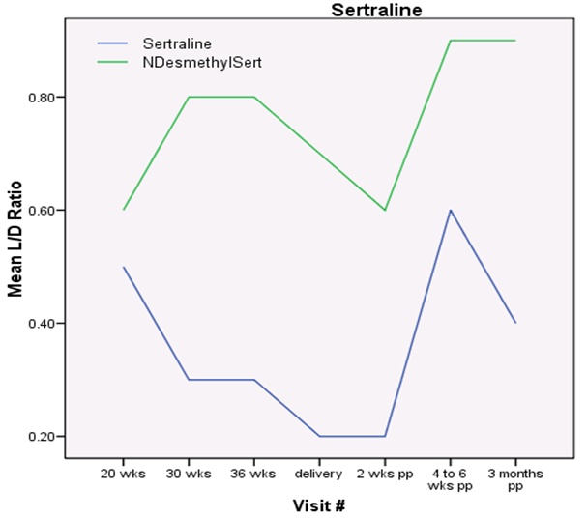



Dose adjustments in pregnancy
Pre-pregnancy
Mid-trimester
Delivery
Delivery
Sit et al., 2008; Hamad et al., 2012.
Notes:
Graph of left demonstrates the mean level:dose ratio (Y axis) and the gestational age or weeks postpartum (X axis)
This graph is specific to sertraline, but similar graphs have been developed for many of the SSRIs. Note that the blue line is sertraline (active drug) and the green is N-desmethyl-sertraline which is the inactive metabolite
When prescribing SSRIs in pregnancy, it is useful to describe this. I use the analogy of kool-aid being diluted in larger volumes of water to explain that often we need to increase the dose as pregnancy progresses to get the same therapeutic response. It also emphasizes how a dose increase is not more exposure to the fetus - it optimizes the chance of only one exposure (medication) and not two exposures (suboptimally treated MDD + medication)
Sit, D. K., Perel, J. M., Helsel, J. C., & Wisner, K. L. (2008). Changes in antidepressant metabolism and dosing across pregnancy and early postpartum. The Journal of clinical psychiatry, 69(4), 2488.
Hamad, G. G., Helsel, J. C., Perel, J. M., Kozak, G. M., McShea, M. C., Hughes, C., ... & Wisner, K. L. (2012). The effect of gastric bypass on the pharmacokinetics of serotonin reuptake inhibitors. American Journal of Psychiatry, 169(3), 256-263.

Slide 36
Case: 27 y/o G1P0 at 30w3d
She responds well to a discussion of treatment and begins escitalopram, which you increase to 15 mg
At her 30 week follow-up, her EPDS is 15 again and she shares that some of her symptoms have re-emerged. She agrees to increase to 20 mg, but….
She expresses a desire to taper her dose down and discontinue medication prior to birth in order to “not make my baby have to go through medication withdrawal”

Slide 37
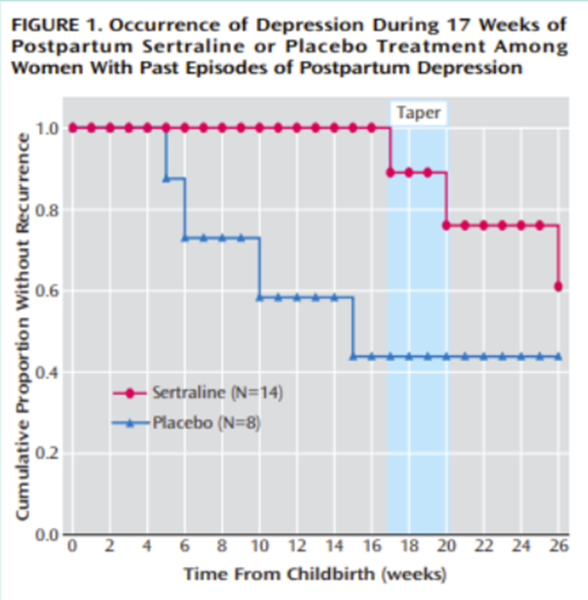
Relapse
Wisner et al., 2004, American Journal of Psychiatry.
The postpartum is a vulnerable time for all-comers but especially for those with history of mental illness
Please see Depression module for outcomes related to untreated depression in the postpartum
Notes:
Remember that PP introduces biological vulnerability, which pregnancy does not, so need extra attention to treatment in PP
Wisner, K. L., Perel, J. M., Peindl, K. S., Hanusa, B. H., Piontek, C. M., & Findling, R. L. (2004). Prevention of postpartum depression: a pilot randomized clinical trial. American Journal of Psychiatry, 161(7), 1290-1292.

Slide 38
Neonatal Adaptation Syndrome
20-30% of SSRI-exposed newborns
May have symptoms of jitteriness, increased muscle tone, rapid breathing – but these are transient, self limited, and not dangerous.
Risk is not related to dose
Risk remains even if SSRI is stopped in third trimester
Notes:
https://www.reprotox.org/
https://mothertobaby.org/fact-sheets/

Slide 39
Case: 27 y/o G1P1, 2 week PP mood check
She remains on escitalopram 20 mg
Labor and delivery were unremarkable
Baby did not experience any issues with neonatal adaptation symptoms.
She is, however, seeking reassurance that it’s okay to breastfeed while taking escitalopram.

Slide 40
Postpartum and Breastfeeding
Postpartum:
Do not stop treatment in the postpartum period. This is the HIGHEST risk time. Most patients need to remain on treatment for a year postpartum.
Breastfeeding:
The vast majority of psychiatric medications are low risk in breastfeeding. Exceptions that require further input: Lithium, Clozapine (avoid), and benzos
LactMed: https://www.ncbi.nlm.nih.gov/books/NBK501922/
Notes:
Burt VK, Suri R, Altshuler L, Stowe Z, Hendrick VC, Muntean E. The use of psychotropic medications during breast-feeding. Am J Psychiatry. 2001;158(7):1001-1009. doi:10.1176/appi.ajp.158.7.1001
Weissman AM, Levy BT, Hartz AJ, et al. Pooled analysis of antidepressant levels in lactating mothers, breast milk, and nursing infants. Am J Psychiatry. 2004;161(6):1066-1078. doi:10.1176/appi.ajp.161.6.1066

Slide 41
Breastfeeding: Further medication considerations
Benzodiazepines:
Discuss risks of sedation with infant care
Monitor infant for sedation (rare), but worth noting
Lithium:
Discuss with your reproductive psychiatry colleagues as there are ways to successfully breastfeed
Clozapine:
Discuss with your reproductive psychiatry colleagues. This is not a medication that you would be starting at any point.

Slide 42
For more information…
On risk-risk discussions outside of SSRIs:
https://ncrptraining.org/wp-content/uploads/2019/12/Risk-Risk_Medications-in-Pregnancy-Self-Study_Trainee.pdf
Notes:
https://ncrptraining.org/wp-content/uploads/2019/12/Risk-Risk_Medications-in-Pregnancy-Self-Study_Trainee.pdf

Slide 43
For more information…
The organizations below offer FREE comprehensive toolkits/algorithms for OBGYN providers to address maternal mental health conditions
ACOG (https://www.acog.org/programs/perinatal-mental-health)
Council on Patient Safety in Women’s Healthcare (alliance for innovations on maternal health) (https://saferbirth.org/psbs/perinatal-mental-health-conditions/)
MCPAP for moms/Lifeline for Moms (https://repository.escholarship.umassmed.edu/handle/20.500.14038/44263)
RCOG (https://www.rcgp.org.uk/clinical-and-research/resources/toolkits/perinatal-mental-health-toolkit.aspx)
And many others…

Slide 44

Other stuff… SLEEP!
We cannot say this enough: new parents, especially those with psychiatric vulnerabilities, need to prioritize sleep.
In fact, we often prescribe sleep.
Prescribe sleep? YES
Sleep is medicine and, especially in first weeks postpartum, we strategize with the patient for 3-5 UNINTERRUPTED hours.
Notes:
The longest uninterrupted stretch is more important than total duration
Leistikow N, Baller EB, Bradshaw PJ, Riddle JN, Ross DA, Osborne LM. Prescribing Sleep: An Overlooked Treatment for Postpartum Depression [published online ahead of print, 2022 Mar 16]. Biol Psychiatry. 2022;S0006-3223(22)01097-6. doi:10.1016/j.biopsych.2022.03.006

Slide 45
Other stuff… SLEEP!
Brief discussions including:
Current sleeping arrangements: Together in one room? Who is getting up with baby if they need something? How much is baby currently sleeping?
Alternative sleep spaces: Do you have a spare place that you could sleep while your spouse/family member/alternative caregiver cares for the baby, e.g. guest room, basement, den?
Are you able to take naps during the day?
What are some ways that you think you can carve out 3-4 hours of uninterrupted sleep?
Breastfeeding: Breastfeeding goals and the role of pumping/formula/feeding will naturally come up. One option, if exclusively breastfeeding is to ask if there is a way that the alternative caregiver can bring the baby in to feed, then take them as soon as they are done for burping/changing/soothing.

Slide 46
Summary
Perinatal mental illness is common
Screening can be done at intake
There are efficient strategies to initiate treatment
It is a risk-risk discuss: Between exposure to untreated illness or exposure to treatment
Patients DO get better
Patients almost always need more than the starting dose of an SSRI/SNRI
Notes:
https://www.reprotox.org/
https://mothertobaby.org/fact-sheets/

Slide 47
Key references
Wisner, Katherine L., et al. "Onset timing, thoughts of self-harm, and diagnoses in postpartum women with screen-positive depression findings." JAMA psychiatry 70.5 (2013): 490-498.
Wisner, Katherine & Perel, James & Peindl, Kathleen & Hanusa, Barbara & Piontek, Catherine & Findling, Robert. (2004). Prevention of Postpartum Depression: A Pilot Randomized Clinical Trial. The American journal of psychiatry. 161. 1290-2. 10.1176/appi.ajp.161.7.1290.
Yonkers, Kimberly A., et al. "The management of depression during pregnancy: a report from the American Psychiatric Association and the American College of Obstetricians and Gynecologists." General hospital psychiatry 31.5 (2009): 403-413.
Moses-Kolko, Eydie L., et al. "Neonatal signs after late in utero exposure to serotonin reuptake inhibitors: literature review and implications for clinical applications." Jama 293.19 (2005): 2372- 2383.
Byatt, Nancy, Kristina M. Deligiannidis, and Marlene P. Freeman. "Antidepressant use in pregnancy: a critical review focused on risks and controversies." Acta Psychiatrica Scandinavica 127.2 (2013): 94-114.Warburton, W., C. Hertzman, and T. F.

Slide 48
Resources list
Psychology today (https://therapists.psychologytoday.com/rms/)
American Psychological association (https://locator.apa.org)
Postpartum support international (www.postpartum.net)
  Online support groups
  Support hotline (1-800-944-4773)
  International therapist locator (https://postpartum.net/get-help/providerdirectory)
MCPAP for Moms OB Toolkit (https://www.mcpapformoms.org/Toolkits/Toolkit.aspx)
Lifeline for Moms OB toolkit (https://www.umassmed.edu/lifeline4moms/products-resources/materials-for-providers/)
Reprotox (https://www.reprotox.org/)
Mother to Baby (https://mothertobaby.org/fact-sheets)
NCRP (https://ncrptraining.org/wp-content/uploads/2019/12/Risk-Risk_Medications-in-Pregnancy-Self-Study_Trainee.pdf)
ACOG (https://www.acog.org/programs/perinatal-mental-health)
Council on Patient Safety in Women’s Healthcare (https://saferbirth.org/psbs/perinatal-mental-health-conditions/)
RCOG (https://www.rcgp.org.uk/clinical-and-research/resources/toolkits/perinatal-mental-health-toolkit.aspx)

