Slide 1

Attachment Self Study
Infant Mental Health and the Parent-Infant Relationship

Slide 2
Learning Objectives
1. Define infant mental health and attachment
2. Describe infant and adult attachment styles
3. Recognize the relationships between infant attachment and adult attachment
4. Understand the evaluation and treatment of issues related to parent-infant relationships

Slide 3
Outline
Infant Mental Health
What is Attachment & Why is it Important?
Infant Attachment Styles and Assessment
The Parent-Infant Relationship
  Intergenerational Transmission of Attachment
  Attachment & the Perinatal Period
Adult Attachment Styles & Assessment
Examples of Treatment for the Parent-Infant Relationship

Slide 4
Infant Mental Health

Slide 5
Infant Mental Health
“…the developing capacity of the child from birth to age three to experience, regulate, and express emotions; form close and secure interpersonal relationships; and explore the environment and learn – all in the context of family, community and cultural expectations for young children” – ZERO to THREE Infant Mental Health Task Force Steering Committee 2001
Early environmental experiences affects an infant’s neurodevelopment and ultimate health and wellbeing throughout their life (Clinton et al. 2016)

Slide 6

The Still Face Paradigm
The Still-Face paradigm (Tronick et al., 1978) is one example of how researchers can assess the impact of an early life experience of maternal non-responsiveness and lack of reciprocity on the parent-infant relationship

Slide 7
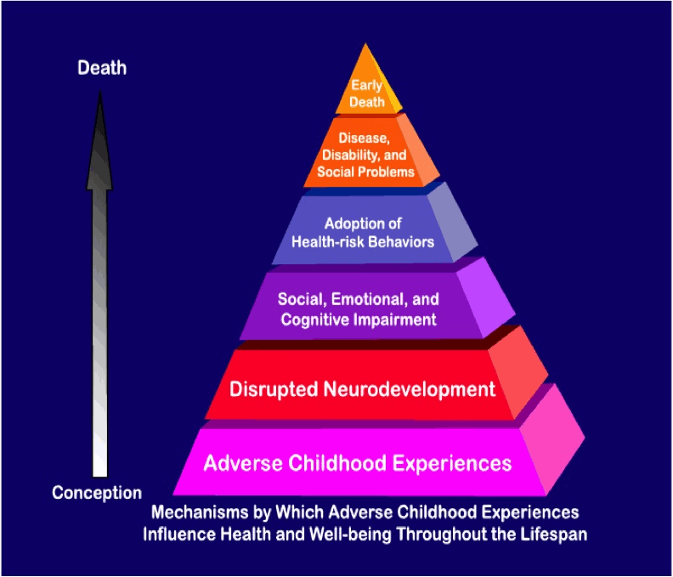
Adverse Childhood Experiences and Infant Mental Health
The importance of infant mental health and early life experiences are clearly demonstrated by research exploring the effect of Adverse Childhood Experiences throughout a person’s life (Felitti et al 1998; Givrad et al 2022).
Adverse Childhood Experiences include early negative interactions with caregivers such as emotional or physical neglect, verbal abuse, and physical abuse (Felitti et al, 1998)
These have been shown to have a profound impact on a wide range of outcomes in adulthood such as the development of high-risk health behaviors and disease, including depression and an increased number of suicide attempts (Felitti et al, 1998),
http://www.aceresponse.org/who_we_are/ACE-Study_43_pg.htm

Slide 8
What is Attachment?

Slide 9
What is Attachment?
Attachment is the bond between an infant and caregiver that provides the infant with a feeling of security and comfort (Bowlby, 1969).
Attachment behaviors are strategies we develop when in distress to get our needs met.
Attachment Style is the working model that develops depending on caregiver responses and determines what we expect from our relationships and ourselves.
Having a stable and secure attachment means that a person feels confident that their attachment figure can be a secure base from which they can freely explore the world, as well as a safe haven from which they can seek comfort if they feel distress.

Slide 10
What is Attachment?
The internal working model of a person’s sense of themselves and others is developed based on early life experiences with attachment figures.
The quality of someone’s attachment can determine whether a person feels they are worthy of love and feels competent as well as whether they can depend on others when needed.
Infant attachment may impact a range of developmental outcomes in early childhood including cognition and behavior (Branjerdporn et al 2017; Fearon et al 2010; Ding et al 2014; Boldt et al 2017) as well as risk for mood disorders later in life (Dozier et al, 2008).

Slide 11
Development of Infant Attachment
Attachment is not immediate; it develops and changes over time through repeated interactions with caregivers
Secure attachment is developed by meeting the infant’s needs with reasonable reliability and warmth
Infant self-regulation & ability to self-soothe is promoted by consistently responsive caregiving and coregulation of emotions with their caregiver (Givrad et. al., 2022)
Infant temperament: individual differences in emotional and motor reactivity that are mostly stable over time and situation (Rothbart and Derryberry 1981)
  Goodness of fit between parent and child temperament also plays a role in the development of secure attachment (Chess and Thomas 1991)

Slide 12

Infant Attachment Styles

Slide 13
How is Infant Attachment Assessed?
In research, one way that an infant’s attachment style is measured is through the Strange Situation Procedure (Ainsworth and Bell, 1970)
This protocol involves observing an infant while he or she experiences a standardized series of separations and reunions with their attachment figure and a stranger
The four main attachment styles and associated behaviors are described in the next few slides
This video shows an example of the Strange Situation Procedure
  https://www.youtube.com/watch?v=QTsewNrHUHU

Slide 14
Attachment Categories & Associated Behavior
Secure Attachment Style
  Happily interacts with caregiver
  Explores environment freely while occasionally checking in with caregiver
  Friendly toward stranger when caregiver is present
  Exhibits distress upon separation from caregiver
  Avoids stranger and limits exploration while separated from caregiver
  Enthusiastically greets caregiver upon return
  Seeks caregiver when distressed and is easily soothes by caregiver
  Trusts that caregiver will be available to meet needs
  (Givrad et. al., 2022, adapted from Ainsworth et al 1978; Main and Solomon 1980)

Slide 15
Attachment Categories & Associated Behavior
Avoidant Attachment Style
  Develops in response to a more rejecting, angry caregiver with restricted affect
  Associated infant/child behaviors:
    Explores environment without acknowledging caregiver
    Limits emotional expression across range of emotions despite physiological arousal
    No outward indication of distress upon separation from caregiver
    Plays as usual when stranger is present and caregiver is absent
    Shows little interest in interaction with caregiver upon return by not moving toward caregiver or seeking contact
  (Givrad et. al., 2022, adapted from Ainsworth et al 1978; Main and Solomon 1980)

Slide 16
Attachment Categories & Associated Behavior
Ambivalent/Resistant Attachment Style
  Develops in response to an inconsistent caregiver who may act nurturing one minute and insensitive the next
  Associated infant/child behaviors:
    Shows unwillingness to explore environment and exhibits fear of stranger
    Displays clingy behavior and exhibits intense distress upon separation from caregiver
    Demonstrates ambivalence toward caregiver upon return and may expresses anger or anxiety when caregiver attempts to soothe
    Struggles to regulate intense emotions and may exaggerate emotional response in effort to elicit attention from caregiver
  (Givrad et. al., 2022, adapted from Ainsworth et al 1978; Main and Solomon 1980)

Slide 17
Attachment Categories & Associated Behavior
Disorganized/Disoriented Attachment Style
  Develops in response to an abusive caregiver who behaves aggressively or bizarrely
  Associated infant/child behaviors:
    Displays inconsistent, unpredictable, and directionless behavior
    Expressed fear and confusion when interacting with caregiver
    Demonstrates unusual and sometimes contradictory behavior in response to caregiver, such as freezing, posturing, or engaging in self-stimulatory behavior (e.g., head-banging)
    Struggles to cope or be comforted when distressed
  (Givrad et. al., 2022, adapted from Ainsworth et al 1978; Main and Solomon 1980)

Slide 18
The Parent-Infant Relationship

Slide 19
Development of the Parent-Infant Dyad
Observable interactions with each other
  Touch, Gaze, Vocalizations
  Coregulation (help infant identify and process emotions) & Reciprocity (give and take interactions)
  Parental Responsiveness
  Handling of Disruption & Repair
  Experienced Pleasure
Unobservable interactions (mental, emotional, & representational)
  Parental Mental Representations (thoughts and expectations about the infant) & Attributions (explanations for the infant’s behavior)
  Parental Reflective Functioning: Capacity to understand mental states
  Infant Internalized Mental Representations/Internal Working Models

Slide 20
Assessment of the Parent-Infant Dyad
Prenatal: Explore how the parents talk about the infant and themselves as parents, their mental representations and worries, the impact on the parental relationship.
Postnatal: Explore the experience of having this infant, transition to parenthood, expectations vs reality, attributions to the infant based on parent’s relational history, traumas, and cultural beliefs.
Analyze observable interactions between the parent and infant
  Sensitivity & Responsiveness
  Handling of disruptions & repair
  Experience of mutual pleasure
  Touch, Gaze, Vocalizations

Slide 21
Intergenerational Transmission of Attachment
Parent attachment style during pregnancy can predict infant attachment style with up to 80% probability (Fonagy, 1991).
Parents whose own early experiences with caregivers result in an insecure attachment style are then faced with the responsibility of providing care of a type that they themselves did not experience.
Insecure attachment style is also a risk factor for perinatal anxiety and depression (Conde et al., 2011) which impacts maternal responsiveness and the development of a healthy attachment relationship and good infant mental health.

Slide 22
Attachment & the Perinatal Period
Meta-analysis of 20 studies confirms link between adult attachment and postpartum depression (Warfa et al., 2014)
Depression symptoms during pregnancy increase with severity of adult attachment issues (Meuti et al., 2015)
Notes:
There have been a number of studies to date examining attachment as a risk factor during the perinatal period. Most have focused on postpartum depression. A recent meta-analysis of 20 studies confirmed that insecure adult attachment style is risk factor for PPD
A 2015 study by Meuti screened 435 women during pregnancy using the EPDS & ECR and identified 89 with depression during pregnancy. The ECR is a 36 item self report measure of attachment for adults. As you can see in this table, they found insecure attachment was more prevalent in the depressed group as measured by the EPDS compared to the control group and that depression sx increased with severity of attachment issues.
Based on these findings the authors conclude, just as in many studies of this phenomenon before this, that the severity of depression seem to increase proportionally to attachment disorganization and therefore attachment should be considered as both an important risk factor as well as a focus for early psychotherapeutic intervention for perinatal women.
Finally, there is less research looking at attachment as a risk factor for perinatal anxiety, but there are a few studies now that also confirm that link.
{Conde et al 2011 found risk factor for both anxiety and PPD using attachment style interview during 2nd trimester for couples and the EPDS and state-anxiety postpartum}
{The Adult Attachment Interview was used to classify 97 mothers as earned secure, continuous secure, and insecure. Home observations of parenting and maternal self-reports of daily hassles (our stress measure) were obtained when children were 27 months old. Planned comparisons revealed that the diathesis-stress/incoherent present state of mind model most accurately predicted parenting. Thus, under high stress, the earned secures parented equivalently to the continuous secures and more positively than the insecures; under low stress no group differences were obtained. These findings indicate that in a normative sample earned secures break the intergenerational cycle and exhibit resilient parenting even under high stress conditions.}
Correlation between the attachment assessed by ECR and the degree of depressive perinatal pathology evaluated via EPDS ,by means of Pearson’s correlation analysis. The dimensions of attachment, both “Avoidance” and “Anxiety,” appear to correlate in a statistically significant manner with the severity of the perinatal depressive disorder in the group PND (“Avoidance-EPDS”: P Pearson = 0.338, 𝑝 = 0.001; “Anxiety-EPDS”:PPearson=0.337, 𝑝 = 0.001). The romantic attachment styles relate in a statistically significant way to the score obtained from the EPDS in the PND group: there was an increase in the average score of the EPDS correlating with the increase of the level of disorganization in the romantic attachment style, as shown in Table4. In particular, the average for patients with the “Secure” attachment style was a 15.16 on the EPDS (SD = 3.08);for a“Dismissing”attachment style it was15.79(SD= 4.28); patients with the “Preoccupied” attachment style had an average of 18.50 (SD = 4.14) and those with the “FearfulAvoidant” attachment style a 19.19 (SD = 4.77) (ANOVA: 𝐹 = 6.276, 𝑝 = 0.001).

Slide 23
Adult Attachment Styles and Assessment

Slide 24
How is Adult Attachment Assessed?
Attachment Styles have been found to be stable over time
George, Kaplan, & Main’s Adult Attachment Interview (1982)
  Involves extensive training and time to implement and score
Self-report measures
  Relationships Questionnaire (RQ; Bartholomew & Horowitz, 1991)
  Relationship Scales Questionnaire (RSQ; Griffin & Bartholomew, 1994)
  Experiences in Close Relationships (ECR-Revised, Fraley
Bartholomew & Horowitz’s Model of Adult Attachment (1991)
  Tested model with two underlying dimensions based on Bowlby’s original theory
    Internal model of SELF (positive or negative)
    Internal model of OTHERS (positive or negative)

Slide 25
Bartholomew & Horowitz’s Model of Adult Attachment
MODEL OF SELF
Positive/Competent Negative/Not Competent
Based on our relational experiences over time we develop working models of SELF and OTHERS:
Do we generally view ourselves as lovable/competent
and others as loving/dependable?
IF SO, we are likely to have a SECURE Attachment Style
SECURE | PREOCCUPIED
DISMISSING | FEARFUL
Positive/Dependable
MODEL OF OTHERS
Negative/Not Dependable
(Bartholomew & Horowitz, 1991)
Notes:
Bartholomew’s four category model of adult attachment (Bartholomew & Horowitz, 1991)
Working model of self (x-axis) and others (y-axis)
So basically the idea is if something stressful happens, am I going to be able to manage it and are people going to be there for me if I need help?
If been abused, will understandably expect the same treatment in new relationships, if rejected/abandoned will expect more rejection
These assumptions may not be accurate however, these working models are imposed inappropriately on current and new relationships
So then we either end up confirming the working model, recreating old relationship patterns and potentially become depressed/anxious or a crisis can be an opportunity to confront and question aspects of our old working models and have different/better relationship experiences.
Secure –Have a sense of self-competence, believe they can manage crises. Generally trust others, believe needs will be met.
I’m OK, You’re OK
Positive self image and view of others
I am competent – have communication, social, coping skills
I can trust others – ask for help and people will respond
What we know is that only a little over half of us are actually securely attached, the rest of us line up better with one or more of the other categories.

Slide 26
Descriptions of Each Attachment Style
MODEL OF SELF
SECURE
“Display openness regarding expressing emotions and thoughts with others and are comfortable with depending on others for help, while also being comfortable with others depending on them.” (Cassidy, 1994)
PREOCCUPIED
”Prone to hyperactivation during times of stress, emotions can become amplified, and overdependence on others is increased.”
(Mikulincer & Shaver, 2003)
MODEL OF OTHERS
DISMISSING
”Prone to hyperactivation during times of stress, emotions can become amplified, and overdependence on others is increased.”
(Mikulincer & Shaver, 2003)
FEARFUL
“Like dismissing avoidant, they often cope with distancing themselves from relationship partners, but unlike dismissing individuals they continue to experience anxiety and neediness concerning their partner’s love, reliability and trustworthiness.”
(Schachner, Shaver & Mikulincer, 2003)
(Bartholomew & Horowitz, 1991)
Notes:
Bartholomew’s four category model of adult attachment (Bartholomew & Horowitz, 1991)
Working model of self (x-axis) and others (y-axis)
So basically the idea is if something stressful happens, am I going to be able to manage it and are people going to be there for me if I need help?
If been abused, will understandably expect the same treatment in new relationships, if rejected/abandoned will expect more rejection
These assumptions may not be accurate however, these working models are imposed inappropriately on current and new relationships
So then we either end up confirming the working model, recreating old relationship patterns and potentially become depressed/anxious or a crisis can be an opportunity to confront and question aspects of our old working models and have different/better relationship experiences.
Secure –Have a sense of self-competence, believe they can manage crises. Generally trust others, believe needs will be met.
I’m OK, You’re OK
Positive self image and view of others
I am competent – have communication, social, coping skills
I can trust others – ask for help and people will respond
What we know is that only a little over half of us are actually securely attached, the rest of us line up better with one or more of the other categories.

Slide 27
Treatment for the Parent-Infant Relationship

Slide 28
Intergenerational Transmission of Attachment
The good news is attachment is not fixed
  Earned Secure Adult Attachment involves reconciling childhood experiences and developing secure relationship patterns as an adult by having more positive relationship experiences over time.
Parents with Earned Secure Attachment can break the intergenerational cycle of attachment issues and exhibit resilient parenting even under high stress environmental conditions.
Understanding Adult Attachment can inform risks to infant mental health and attachment as well as be an important point of intervention during pregnancy and infancy.

Slide 29
Interventions for Parent-Child Relationship Difficulties
Pharmacotherapy and/or psychotherapy for parental mental health
Education for parents about normal development to form realistic expectations for their infant
Parent-infant psychotherapy
  Relationship as target of intervention
  Treatments include a range of practical & behavioral interventions as well as focusing on the emotional dynamics between parent and infant
  Strength-based & culturally informed
  Treatments with a focus on the mother-infant dyad that also address maternal mental health (e.g., Mother-Infant Therapy Group & Mom Power)

Slide 30
Examples of Evidence-based Parent-Infant Interventions
Attachment and Biobehavioral Catch-up
Child-Parent Psychotherapy
Circle of Security
Incredible Years
Parent-Child Interaction Therapy
Promotion First Relationships
Theraplay
Trauma-focused cognitive behavioral therapy
Watch, Wait, and Wonder

Slide 31
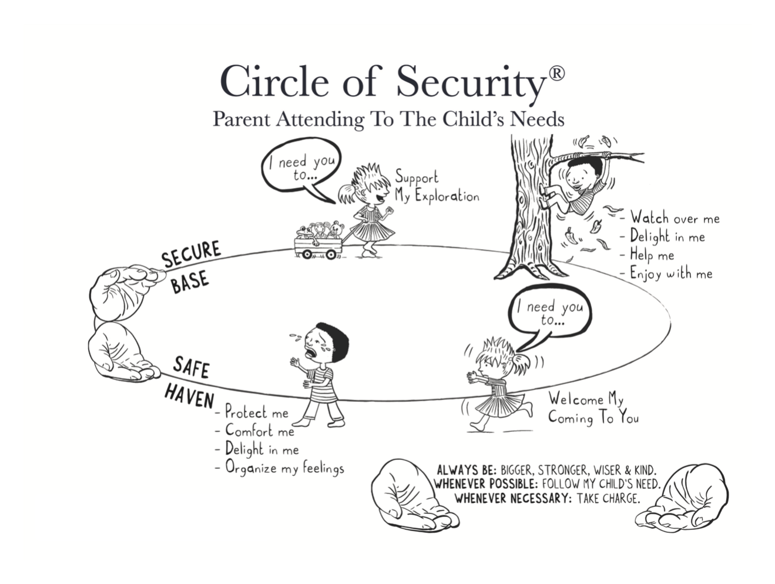
Example handout from the Circle of Security intervention: “A Visual Map of Caregiver-Child Attachment”

Slide 32
Further Reading
Givrad, S., Paul, J.J., Wittmann, C., Nadal-Vicens, M., & St. John-Larken, C. (2022). Infant Mental Health and the Parent-Infant Relationship: Essentials, Assessment, and Treatment. Textbook of Women’s Reproductive Mental Health, American Psychiatric Association.
Psychotherapy with Infants and Young Children: Repairing the Effects of Stress and Trauma on Early Attachment by Alicia Lieberman
Adult Attachment: A Concise Introduction to Theory and Research (2016) by Gillath, Karantzas, & Fraley
Improving Patient Treatment with Attachment Theory: A Guide for Primary Care Practitioners and Specialists Edited by Jon Hunter & Robert Maunder (2015)
Bartholomew, K., & Horowitz, L.M. (1991). Attachment styles among young adults: A test of a four-category model. Journal of Personality and Social Psychology, 61(2), 226
The Circle of Security Intervention: Enhancing Attachment in Early Parent-Child Relationships (2016) by Powell, Cooper, Hoffman, & Marvin

Slide 33
References
Ainsworth MDS, Blehar MC, Waters E, et al: Patterns of Attachment: A Study of the Strange Situation. Hillsdale, NJ, Erlbaum, 1978
Ainsworth MD, Bell SM: Attachment, exploration, and separation: illustrated by the behavior of one-year-olds in a strange situation. Child Dev 41(1):49–67, 1970 5490680
Bartholomew, K., & Horowitz, L. M. (1991). Attachment styles among young adults: a test of a four-category model. Journal of personality and social psychology, 61(2), 226.
Boldt LJ, Kochanska G, Jonas K: Infant attachment moderates paths from early negativity to preadolescent outcomes for children and parents. Child Dev 88(2):584–596, 2017 27569427
Branjerdporn G, Meredith P, Strong J, Garcia J. Associations Between Maternal-Foetal Attachment and Infant Developmental Outcomes: A Systematic Review. Matern Child Health J. 2017 Mar;21(3):540-553. doi: 10.1007/s10995-016-2138-2. PMID: 27456309.
Cassidy, J. (1994). Emotion regulation: Influences on attachment relationships. Monographs of the Society for Research in Child Development, 59, 228-249.

Slide 34
References
Chess, S., & Thomas, A. (1991). Temperament and the concept of goodness of fit. In J. Strelau & A. Angleitner (Eds.), Explorations in temperament: International perspectives on theory and measurement (pp. 15–28). Plenum Press.
Cicchetti D, Rogosch FA, Toth SL: Fostering secure attachment in infants in maltreating families through preventive interventions. Dev Psychopathol 18(3):623–649, 2006 17152394
Clinton J, Feller AF, Williams RC: The importance of infant mental health. Paediatr Child Health 21(5):239–241, 2016 27441014
Collins, N. L., Ford, M. B., Guichard, A. C., & Allard, L. M. (2006). Working Models of Attachment and Attribution Processes in Intimate Relationships. Personality and Social Psychology Bulletin, 32(2), 201–219.
Conde, Ana & Figueiredo, Barbara & Bifulco, Antonia. (2011). Attachment style and psychological adjustment in Couples. Attachment & human development. 13. 271-91.

Slide 35
References
Ding YH, Xu X, Wang ZY, et al: The relation of infant attachment to attachment and cognitive and behavioural outcomes in early childhood. Early Hum Dev 90(9):459–464, 2014 25000392
Dozier, M., & Rutter, M. (2008). Challenges to the development of attachment relationships faced by young children in foster and adoptive care. In J. Cassidy & P. R. Shaver (Eds.), Handbook of attachment: Theory, research, and clinical applications (pp. 698–717). The Guilford Press.
Facompré CR, Bernard K, Waters TEA: Effectiveness of interventions in preventing disorganized attachment: a meta-analysis. Dev Psychopathol 30(1):1–11, 2018 28397637
Fearon RP, Bakermans-Kranenburg MJ, van Ijzendoorn MH, Lapsley AM, Roisman GI. The significance of insecure attachment and disorganization in the development of children's externalizing behavior: a meta-analytic study. Child Dev. 2010 Mar-Apr;81(2):435-56. doi: 10.1111/j.1467-8624.2009.01405.x. PMID: 20438450.
Felitti VJ, Anda RF, Nordenberg D, et al: Relationship of childhood abuse and household dysfunction to many of the leading causes of death in adults: the Adverse Childhood Experiences (ACE) study. Am J Prev Med 14(4):245–258, 1998 9635069
Fraley, R. C., Heffernan, M. E., Vicary, A. M., & Brumbaugh, C. C. (2011). The experiences in close relationships—Relationship Structures Questionnaire: A method for assessing attachment orientations across relationships. Psychological assessment, 23(3), 615.
Fonagy, P., Steele, M., Steele, H., Moran, G. S., & Higgitt, A. C. (1991). The capacity for understanding mental states: The reflective self in parent and child and its significance for security of attachment. Infant Mental Health Journal, 12 (3), 201–218.

Slide 36
References
George, C., Kaplan, N., & Main, M. (1985). Adult Attachment Interview. Unpublished manuscript, Berkeley, CA: University of California.
Griffin, D. W., & Bartholomew, K. (1994). Models of the self and other: Fundamental dimensions underlying measures of adult attachment. Journal of Personality and Social Psychology, 67(3), 430–445.
Main M, Solomon J: Procedures for identifying infants as disorganized/disoriented during the Ainsworth strange situation, in Attachment in the Preschool Years: Theory, Research, and Intervention. Edited by Greenberg MT, Cicchetti D, Cummings EM. Chicago, IL, University of Chicago Press, 1990, pp 121–160
Meuti V, Aceti F, Giacchetti N, Carluccio GM, Zaccagni M, Marini I, Giancola O, Ciolli P, & Biondi M. (2015). Perinatal Depression and Patterns of Attachment: A Critical Risk Factor? Depression Research & Treatment, 27(2), 77–102.
Mikulincer, M., & Shaver, P. R. (2003). The attachment behavioral system in adulthood: Activation, psychodynamics, and interpersonal processes. Journal of Personality and Social Psychology, 81, 97-115.
Rothbart, M. K., & Derryberry, D. (1981). Development of Individual Difference in Temperament. In M. E. Lamb, & A. L. Brown (Eds.), Advances in Developmental Psychology (pp. 37-86). Hillsdale, NJ: Lawrence Erlbaum Associates.
Schachner, D. A., Shaver, P. R., & Mikulincer, M. (2003). Adult Attachment Theory, Psychodynamics, and Couple Relationships: An Overview.
Tronick, E., Als, H., Adamson, L., Wise, S., and Brazelton, T. B. (1978). The infant’s response to entrapment between contradictory messages in face-to-face interaction. J. Am. Acad. Child Psychiatry 17, 1–13. doi: 10.1016/S0002-7138(09)62273-1
Warfa, N., Harper, M., Nicolais, G. et al. Adult attachment style as a risk factor for maternal postnatal depression: a systematic review. BMC Psychol 2, 56 (2014).

