Slide 1
COCAINE USE IN THE PERINATAL PERIOD
LAUREN AUGELLO, MD

Slide 2
Objectives
Appreciate the impact of the cocaine epidemic of the 1980s on pregnant women with substance use disorders then and now.
Learn how to lower the barriers of care and engage women in treatment through screening and follow up as indicated.
Gain a basic understanding of the mechanism of action and adverse effects of cocaine use in pregnancy and postpartum.
Become familiar with evidence-based treatments for cocaine use disorder.

Slide 3
The Story of Jennifer Johnson
In the 1980s the US government shifted drug control efforts from the public health sector to the criminal justice system contributing to or as a result of the media frenzy surrounding the crack cocaine epidemic.
In 1989 Jennifer Johnson became the first woman convicted of delivering drugs to a minor by passing cocaine to her baby through the umbilical cord in the minutes after the baby was born and before the cord was clamped.
Bishop, Darla; Borkowski, Liz; Couillard, Megan; Allina, Amy; Baruch, Susanna; and Wood, Susan, "Pregnant Women and Substance Use: Overview of Research & Policy in the United States" (2017). Jacobs Institute of Women's Health. Paper 5. http://hsrc.himmelfarb.gwu.edu/sphhs_centers_jacobs/5.; Press, From Associated. “Mother Convicted as Drug Deliverer After Cocaine Is Found in Newborns.” Los Angeles Times, Los Angeles Times, 14 July 1989, articles.latimes.com/1989-07-14/news/mn-3733_1_umbilical-cord.

Slide 4
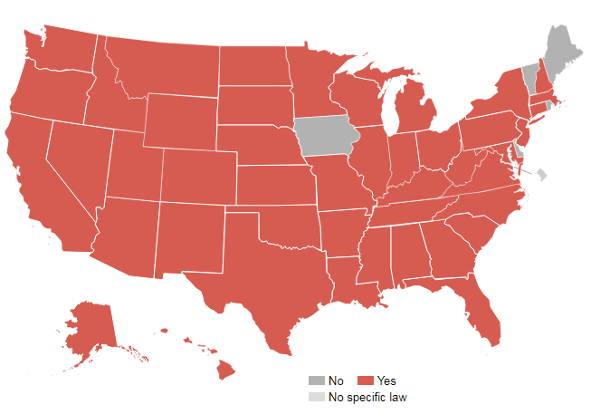
Barriers to Care
“Authorities in at least 45 states have sought to prosecute women for exposing their unborn children to drugs. ”
Miranda, Leticia, et al. “How States Handle Drug Use During Pregnancy.” projects.propublica.org/graphics/maternity-drug-policies-by-state.

Slide 5
Barriers to Care
According to a retrospective cohort study:
Women who used cocaine and opiates were more than six times more likely than those not using drugs to have received no prenatal care or only one prenatal care visit.
The fear of being reported to the police or child welfare was strongly associated with lack of prenatal care.
https://pixabay.com/photos/palisade-fence-boards-fence-slats-1588766/
Schempf, A. H., & Strobino, D. M. (2009). Drug use and limited prenatal care: an examination of responsible barriers. American Journal of Obstetrics and Gynecology, 2004, 412.e1–412.e10.

Slide 6
Access to Care
Research demonstrates that punitive policies applied to substance use do not improve outcomes and may lead women to avoid accessing prenatal care or SUD treatment.
Improved outcomes are associated with public health models that emphasize harm reduction and access to treatment.
Bishop, Darla; Borkowski, Liz; Couillard, Megan; Allina, Amy; Baruch, Susanna; and Wood, Susan, "Pregnant Women and Substance Use: Overview of Research & Policy in the United States" (2017). Jacobs Institute of Women's Health. Paper 5. http://hsrc.himmelfarb.gwu.edu/sphhscentersjacobs/5

Slide 7
Access to Care
Early prenatal care is recommended for the best possible maternal and infant outcomes (CDC, 2011).
https://www.pexels.com/photo/person-using-black-blood-pressure-monitor-905874/
Maternal and Infant Health. Centers for Disease Control and Prevention. https://www.cdc.gov/reproductivehealth/maternalinfanthealth/. Published January 12, 2017. Accessed March 26, 2017.

Slide 8
Overcoming Barriers to Care
Conduct a careful, empathetic, and nonjudgmental interview.
Inform the patient that because substance use is common, all patients are asked the same questions about substance use.
Substance Abuse and Mental Health Services Administration. Clinical Guidance for Treating Pregnant and Parenting Women With Opioid Use Disorder and Their Infants. HHS Publication No. (SMA) 18-5054. Rockville, MD: Substance Abuse and Mental Health Services Administration, 2018.

Slide 9
Screening
Universal screening is recommended by multiple professional organizations including ACOG, AAP, AMA and CDC.
Screening can be interview-based or self-administered with screening tools.
There are few validated screening tools in pregnancy that screen for substance use outside of alcohol.
The 4Ps Plus is validated in the obstetric population and screens for all substances with a sensitivity of 87% and specificity of 76%. It is not available in the public domain.
The 4Ps tool, developed by Hope Ewing, is available in the public domain and can also be used for screening (http://www.dbhds.virginia.gov/library/mental%20health%20services/screener-4Ps.pdf)
Drug toxicology is NOT recommended for universal screening because it has limitations and should only be considered if there is a clinical indication and with consent.
Chasnoff IJ, Wells AM, McGourty RF, Bailey LK. Validation of the 4P’s plus screen for substance use in pregnancy validation of the 4P’s plus. Journal of Perinatology : Official Journal of the California Perinatal Association. 2007;27(12):744–748.; Wright, Tricia E. et al. The Role of Screening, Brief Intervention, and Referral to Treatment in the Perinatal Period. 2016;215(5):539-547

Slide 10
Approach
To ensure that substance use is thoughtfully and effectively addressed consider following up with the SBIRT protocol as appropriate:
SCREENING quickly assesses the severity of substance use and identifies the appropriate level of treatment.
BRIEF INTERVENTION focuses on increasing insight and awareness regarding substance use and motivation toward behavioral change.
REFERRAL TO TREATMENT provides those identified as needing more extensive treatment with access to specialty care.
Substance Abuse and Mental Health Services Administration. Clinical Guidance for Treating Pregnant and Parenting Women With Opioid Use Disorder and Their Infants. HHS Publication No. (SMA) 18-5054. Rockville, MD: Substance Abuse and Mental Health Services Administration, 2018.; Wright, Tricia E. et al. The Role of Screening, Brief Intervention, and Referral to Treatment in the Perinatal Period. 2016;215(5):539-547

Slide 11
Epidemiology
According to the 2015 National Survey on Drug Use and Health:
1.38 million reproductive age (15 to 44 y old) women used a stimulant in past month (misuse of stimulant prescriptions 1.0%; cocaine 0.7%; methamphetamine 0.7%; ecstasy 0.3%)
3.4% of pregnant women used cocaine in the past month.
Cocaine was the second most common illicit substance used by pregnant women. The most commonly used illicit substance was marijuana.
Among women who also use opioids for nonmedical purposes, 9.4% of reproductive age women (18 to 44 y) used cocaine in the past 30 days.
Center for Behavioral Health Statistics and Quality. (2016). 2015 National Survey on Drug Use and Health: Detailed Tables. Substance Abuse and Mental Health Services Administration, Rockville, MD; Jarlenski M, Barry CL, Gollust S, et al. Polysubstance use among US women of reproductive age who use opioids for nonmedical reasons. Am J Public Health. 2017;107:1308–1310.; Smid M, et al. Stimulant Use in Pregnancy: An Under-recognized Epidemic Among Pregnant Women. Clinical Obstetrics & Gynecology. 2019. 62(1):168-184.

Slide 12
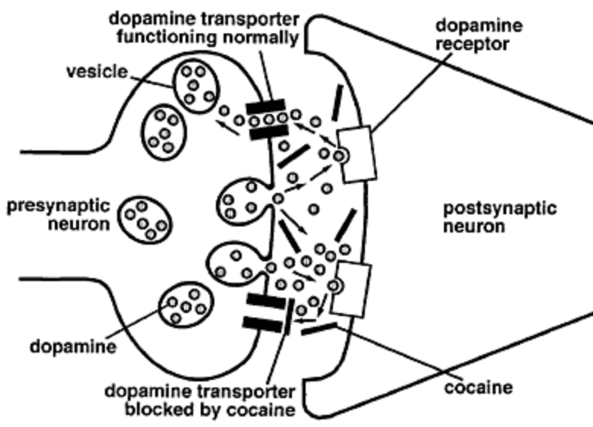
Mechanism of Action
Believed to cross the blood brain barrier and placenta by simple diffusion
Cocaine blocks the reuptake of dopamine by the dopamine transporter
This floods the synapse with dopamine leading to prolonged stimulation of the brain’s pleasure circuits.
It also blocks the presynaptic reuptake transporters for serotonin and norepinephrine causing systemic vasoconstriction.
http://science.education.nih.gov
Gold MS, Washton AM, Dackis CA. Cocaine abuse: neurochemistry, phenomenology, and treatment. Cocaine use in America: epidemiologic and clinical perspectives. NIDA Res Monogr. 1985;61: 130–150. Gouin K, Murphy K, Shah PS. Effects of cocaine use during pregnancy on low birthweight and preterm birth: systematic review and metaanalyses. Am J Obstet Gynecol. 2011; 204:340.e1–.e12. [PubMed: 21257143; Krishna RB, Levitz M, Dancis J. Transfer of cocaine by the perfused human placenta: the effect of binding to serum proteins. Am J Obstet Gynecol. 1993;169:1418–1423.; Pitts D, Marwah J. Autonomic actions of cocaine. Can J Physiol Pharmacol. 1989;67:1168–1176.

Slide 13
Pharmacology
Onset of action:
Intravenous or inhaled: seconds
Intranasal or gastrointestinal: 20-90 minutes
Duration of action:
Intravenous or inhaled: 15-30 minutes
Intranasal or gastrointestinal: 1-3 hours
Half-life:
about 1 hour
Metabolism and Elimination:
Primarily hepatically metabolized
Eliminated in urine
https://www.pexels.com/photo/black-black-and-white-business-cocaine-322251/

Slide 14
Behavioral Effects of Cocaine Use
INITIAL | HIGHER DOSES/LONGER DURATION OF USE | WITHDRAWAL (resolves within 1-2 weeks)
Euphoria | Dysphoric mood | Dysphoric mood
Alertness | Panic attacks | Fatigue
Wakefulness | Paranoia | Vivid unpleasant dreams
Increased confidence | Grandiosity | Insomnia/Hypersomnia
Hyperactivity | Anxiety | Increased appetite
Loss of appetite | Psychosis | Psychomotor agitation/retardation
Changes in sociability | Hypervigilance | Suicidal ideation
 | Stereotyped behaviors

Slide 15
Short-term Physiologic Effects of Cocaine Use
Acute
Tachycardia
Hypertension
Tachypnea
Increased body temperature
Mydriasis
Diaphoresis/Chills
Nausea/vomiting
Dystonia/dyskinesias

Slide 16
Potential Long Term Effects of Cocaine Use
Chronic Use (including but not limited to)
Malnourishment
Movement Disorders
Persistent psychosis
Cognitive impairment
Nosebleeds
Cough/SOB/asthma exacerbation/pulmonary infection
Decreased gastric motility
Injection use associated with HIV/Hepatitis C/Skin and soft tissue infections

Slide 17
Maternal/Serious Adverse Effects
Hypertension
Myocardial infarction and ischemia
Cardiovascular complications may be exacerbated by elevated progesterone
Rhabdomyolysis
Renal failure
Hepatic rupture
Cerebral ischemia and infarction
Maternal death
Seizure
Vasoconstriction of maternal vessels may lead to utero-placental insufficiency, acidosis and fetal hypoxia
*Can mimic pre-eclampsia and eclampsia
Do not wait for urine toxicology results to initiate treatment/prophylaxis for pre-eclampsia/eclampsia.
Some observed effects could be related to polysubstance use
Krishna RB, Levitz M, Dancis J. Transfer of cocaine by the perfused human placenta: the effect of binding to serum proteins. Am J Obstet Gynecol. 1993;169:1418–1423.; Pitts D, Marwah J. Autonomic actions of cocaine. Can J Physiol Pharmacol. 1989;67:1168–1176. Smid M, et al. Stimulant Use in Pregnancy: An Under-recognized Epidemic Among Pregnant Women. Clinical Obstetrics & Gynecology. 2019. 62(1):168-184.
.

Slide 18
Perinatal Adverse Effects
Premature rupture of membranes
Placental abruption
Preterm birth (OR = 3.38; 95% CI: 2.72–4.21)
Low birth weight (OR = 3.66; 95% CI: 2.90– 4.63)
Small for gestational age (OR = 3.23; 95% CI: 2.43–4.30)
n.b. Many of these effects cannot be specifically attributed to cocaine exposure due to widespread confounding, especially other maternal tobacco or other substance use
Acker D, Sachs BP, Tracey KJ, et al. Abruptio placentae associated with cocaine use. Am J Obstet Gynecol. 1983;146:220–221; Bhuvaneswar CG, Chang G, Epstein LA, Stern TA. Cocaine and Opioid Use During Pregnancy: Prevalence and Management. Primary Care Companion to The Journal of Clinical Psychiatry. 2008; 10:59–65.; Chasnoff IJ, Burns WJ, Schnoll SH, et al. Cocaine use in pregnancy. N Engl J Med. 1985;313: 666–669. Dombrowski MP, Wolfe HM, Welch RA, et al. Cocaine abuse is associated with abruptio placentae and decreased birth weight, but not shorter labor. Obstet Gynecol. 1991;77:139–141.; Gouin K, Murphy K, Shah PS. Effects of cocaine use during pregnancy on low birthweight and preterm birth: systematic review and metaanalyses. Am J Obstet Gynecol. 2011;204: 340. e1–e12.
S

Slide 19
Lactation
Breastfeeding is contraindicated in active cocaine use according to the AAP.
Prenatal Substance Abuse: Short- and Long-term Effects on the Exposed Fetus Marylou Behnke, Vincent C. Smith, COMMITTEE ON SUBSTANCE ABUSE, COMMITTEE ON FETUS AND NEWBORN Pediatrics Mar 2013, 131 (3) e1009-e1024; DOI: 10.1542/peds.2012-393; Gartner LM, Morton J, Lawrence RA, et al; American Academy of Pediatrics Section on Breastfeeding. Breastfeeding and the use of human milk. Pediatrics. 2005;115 (2):496–506
Image by gdakaska from Pixabay

Slide 20
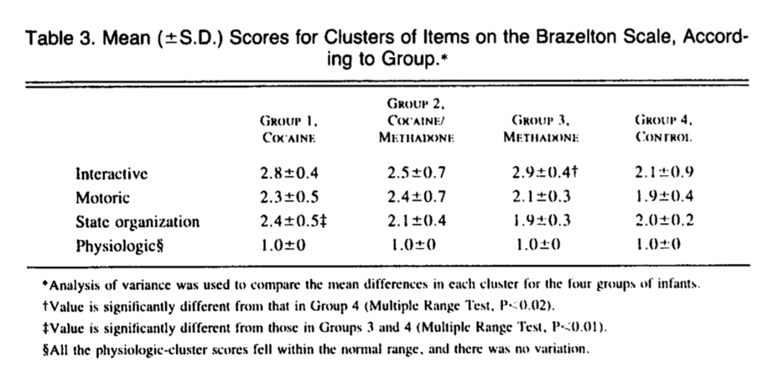
Long Term Adverse Effects: Media Myth
The original claims of cocaine’s devastating effects on childhood development were based on a small study (n = 23) published in the New England Journal of Medicine which found that cocaine exposed infants had “significant depression of interactive behavior and a poor organizational response to environmental stimuli.”
The public concluded from these preliminary findings that cocaine exposure in pregnancy would result in an entire generation of neurodevelopmentally disabled children who would overwhelm schools and cost billions.
Chasnoff IJ, Burns WJ, Schnoll SH, et al. Cocaine use in pregnancy. N Engl J Med. 1985;313: 666–669.
Chasnoff IJ, Burns WJ, Schnoll SH, et al. Cocaine use in pregnancy. N Engl J Med. 1985;313: 666–669.; Winerip, M. (2013, May 20). Revisiting the 'Crack Babies' Epidemic That Was Not. Retrieved from https://www.nytimes.com/2013/05/20/booming/revisiting-the-crack-babies-epidemic-that-was-not.html

Slide 21
Long Term Adverse Effects: Media Myth
The severity of the reported effects of prenatal cocaine exposure have since been disputed through further research, time and testimonials from now adults who were unfairly labeled as children.
Much of what the pediatricians were seeing at the time could not be separated from confounders (e.g. prematurity, tobacco or other substance use).
Ackerman JP, Riggins T, Black MM. A review of the effects of prenatal cocaine exposure among school-aged children. Pediatrics. 2010;125(3):554-565. doi:10.1542/peds.2009-0637.; Bandstra ES, Voge AL, Morrow CE, Xue L, Anthony JC. Severity of prenatal cocaine exposure and child language.; Buckingham-Howes S, Berger SS, Scaletti LA, Black MM. Systematic review of prenatal cocaine exposure and adolescent development. Pediatrics. 2013;131(6):e1917-e1936. doi:10.1542/peds.2012-0945.; Cain MA, Bornick P, Whiteman V. The maternal, fetal, and neonatal effects of cocaine exposure in pregnancy. Clin Obstet Gynecol. 2013;56(1):124-132.; Chaplin TM, Freiburger MB, Mayes LC, Sinha R. Prenatal cocaine exposure, gender, and adolescent stress response: a prospective longitudinal study. Neurotoxicol Teratol. 2010; 32:595– 604.; Chasnoff IJ, Burns WJ, Schnoll SH, et al. Cocaine use in pregnancy. N Engl J Med. 1985;313: 666–669.; Winerip, M. (2013, May 20). ; Frank, D. A., Augustyn, M., Knight, W. G., Pell, T., & Zuckerman, B. (2001). Growth, development, and behavior in early childhood following prenatal cocaine exposure: a systematic review. JAMA, 285(12), 1613-25.; Lambert BL, Bauer CR. Developmental and behavioral consequences of prenatal cocaine exposure: a review. J Perinatol Off J Calif Perinat Assoc. 2012;32(11):819-828. doi:10.1038/jp.2012.90.; Winerip, M. (2013, May 20). Revisiting the 'Crack Babies' Epidemic That Was Not. Retrieved from https://www.nytimes.com/2013/05/20/booming/revisiting-the-crack-babies-epidemic-that-was-not.html
Notes:
Ackerman JP, Riggins T, Black MM. A review of the effects of prenatal cocaine exposure among school-aged children. Pediatrics. 2010;125(3):554-565. doi:10.1542/peds.2009-0637.; Bandstra ES, Voge AL, Morrow CE, Xue L, Anthony JC. Severity of prenatal cocaine exposure and child language.; Buckingham-Howes S, Berger SS, Scaletti LA, Black MM. Systematic review of prenatal cocaine exposure and adolescent development. Pediatrics. 2013;131(6):e1917-e1936. doi:10.1542/peds.2012-0945.; Cain MA, Bornick P, Whiteman V. The maternal, fetal, and neonatal effects of cocaine exposure in pregnancy. Clin Obstet Gynecol. 2013;56(1):124-132.; Chaplin TM, Freiburger MB, Mayes LC, Sinha R. Prenatal cocaine exposure, gender, and adolescent stress response: a prospective longitudinal study. Neurotoxicol Teratol. 2010; 32:595– 604.; Chasnoff IJ, Burns WJ, Schnoll SH, et al. Cocaine use in pregnancy. N Engl J Med. 1985;313: 666–669.; Winerip, M. (2013, May 20). ; Frank, D. A., Augustyn, M., Knight, W. G., Pell, T., & Zuckerman, B. (2001). Growth, development, and behavior in early childhood following prenatal cocaine exposure: a systematic review. JAMA, 285(12), 1613-25.; Lambert BL, Bauer CR. Developmental and behavioral consequences of prenatal cocaine exposure: a review. J Perinatol Off J Calif Perinat Assoc. 2012;32(11):819-828. doi:10.1038/jp.2012.90.; Winerip, M. (2013, May 20). Revisiting the 'Crack Babies' Epidemic That Was Not. Retrieved from https://www.nytimes.com/2013/05/20/booming/revisiting-the-crack-babies-epidemic-that-was-not.html

Slide 22
Long Term Adverse Effects: Media Myth
While subtle differences in behavior, information processing, attention, language and self-regulation may be due to prenatal cocaine exposure, it is difficult to estimate the full extent of the effect of a particular drug in pregnancy given multiple variables including:
Amount used
Other substances used (including tobacco)
Amount of prenatal care
Exposure to violence
Socioeconomic conditions
Nutrition
Other health conditions
Parenting style
Childhood trauma exposure, etc.

Slide 23
Long Term Adverse Effects: Media Myth
For a more in depth look at the individual and societal impact of cocaine use in pregnancy please follow the link below:
https://www.nytimes.com/interactive/2018/12/28/opinion/crack-babies-racism.html

Slide 24
Treatment
Current evidence based treatments for cocaine use in pregnancy include behavioral interventions with support for:
Cognitive Behavioral Therapy
Motivational Interviewing
Contingency Management
There are no evidence-based pharmacologic treatments
Hull L, May J, Farrell-Moore D, Svikis DS. Treatment of cocaine abuse during pregnancy: translating research to clinical practice. Curr Psychiatry Rep. 2010; 12:454–61.; Schottenfeld RS, Moore B, Pantalon MV. Contingency management with community reinforcement approach or twelve-step facilitation drug counseling for cocaine dependent pregnant women or women with young children. Drug Alcohol Depend. 2011; 118:48–55; Terplan M, Ramanadhan S, Locke A, Longinaker N, Lui S. Psychosocial interventions for pregnant women in outpatient illicit drug treatment programs compared to other interventions. Cochrane Database Syst Rev. 2015.; Yonkers KA, Forray A, Howell HB, et al. Motivational enhancement therapy coupled with cognitive behavioral therapy versus brief advice: a randomized trial for treatment of hazardous sub- stance use in pregnancy and after delivery. Gen Hosp Psychiatry 2012;34:439–49.

Slide 25
What Happened to Jennifer Johnson?
The Supreme Court of Florida overturned Jennifer Johnson’s conviction 3 years after she was charged.
The dissenting opinion stated that Ms. Johnson could have avoided "delivering" the drugs only by severing the umbilical cords, an act that could have killed her and her children.
The unanimous decision by seven judges of the Florida Supreme Court quoted that dissent extensively, and ruled that the Florida Legislature had never intended "to use the word 'delivery' in the context of criminally prosecuting mothers for delivery of a controlled substance to a minor by way of the umbilical cord.
Lewin T. Mother Cleared of Passing Drug to Babies. New York Times. http://www.nytimes.com/1992/07/24/news/mother-cleared-of-passing-drug-to-babies.html. Published July 24, 1992. Accessed March 21, 2017.

Slide 26
Summary
There are many lessons to be learned from how both the field of medicine and the media approached the cocaine epidemic.
Pregnant women with substance use disorders were adversely affected by the criminalization of use in pregnancy.
We have learned that through nonjudgemental interview, universal screening, education, motivational enhancement and referral to specialty care as indicated we can retain patients in both prenatal and addictions care thus improving outcomes for families.
Cocaine is a potent activator of the brain’s reward circuitry with evidence-based treatment in pregnancy limited to psychosocial interventions.
It causes systemic vasoconstriction with numerous potential life threatening maternal and fetal consequences.

Slide 27
References
Acker D, Sachs BP, Tracey KJ, et al. Abruptio placentae associated with cocaine use. Am J Obstet Gynecol. 1983;146:220–221
Ackerman JP, Riggins T, Black MM. A review of the effects of prenatal cocaine exposure among school-aged children. Pediatrics. 2010;125(3):554-565. doi:10.1542/peds.2009-0637.
American Psychiatric Association: Desk Reference to the Diagnostic Criteria from DSM-5. Arlington, VA, American Psychiatric Association, 2013.
Bishop, Darla; Borkowski, Liz; Couillard, Megan; Allina, Amy; Baruch, Susanna; and Wood, Susan, "Pregnant Women and Substance Use: Overview of Research & Policy in the United States" (2017). Jacobs Institute of Women's Health. Paper 5. http://hsrc.himmelfarb.gwu.edu/sphhs_centers_jacobs/5.
Bhuvaneswar CG, Chang G, Epstein LA, Stern TA. Cocaine and Opioid Use During Pregnancy: Prevalence and Management. Primary Care Companion to The Journal of Clinical Psychiatry. 2008; 10:59–65.
Buckingham-Howes S, Berger SS, Scaletti LA, Black MM. Systematic review of prenatal cocaine exposure and adolescent development. Pediatrics. 2013;131(6):e1917-e1936. doi:10.1542/peds.2012-0945.
Cain MA, Bornick P, Whiteman V. The maternal, fetal, and neonatal effects of cocaine exposure in pregnancy. Clin Obstet Gynecol. 2013;56(1):124-132.
Center for Behavioral Health Statistics and Quality. (2016). 2015 National Survey on Drug Use and Health: Detailed Tables. Substance Abuse and Mental Health Services Administration, Rockville, MD; Jarlenski M, Barry CL, Gollust S, et al. Polysubstance use among US women of reproductive age who use opioids for nonmedical reasons. Am J Public Health. 2017;107:1308–1310.
Chasnoff IJ, Burns WJ, Schnoll SH, et al. Cocaine use in pregnancy. N Engl J Med. 1985;313: 666–669.
Chasnoff IJ, Wells AM, McGourty RF, Bailey LK. Validation of the 4P’s plus screen for substance use in pregnancy validation of the 4P’s plus. Journal of Perinatology : Official Journal of the California Perinatal Association. 2007;27(12):744–748.
Dombrowski MP, Wolfe HM, Welch RA, et al. Cocaine abuse is associated with abruptio placentae and decreased birth weight, but not shorter labor. Obstet Gynecol. 1991;77:139–141.
Frank, D. A., Augustyn, M., Knight, W. G., Pell, T., & Zuckerman, B. (2001). Growth, development, and behavior in early childhood following prenatal cocaine exposure: a systematic review. JAMA, 285(12), 1613-25

Slide 28
References
Gold MS, Washton AM, Dackis CA. Cocaine abuse: neurochemistry, phenomenology, and treatment. Cocaine use in America: epidemiologic and clinical perspectives. NIDA Res Monogr. 1985;61: 130–150.
Gouin K, Murphy K, Shah PS. Effects of cocaine use during pregnancy on low birthweight and preterm birth: systematic review and metaanalyses. Am J Obstet Gynecol. 2011; 204:340.e1–.e12.
Hull L, May J, Farrell-Moore D, Svikis DS. Treatment of cocaine abuse during pregnancy: translating research to clinical practice. Curr Psychiatry Rep. 2010; 12:454–61.
Krishna RB, Levitz M, Dancis J. Transfer of cocaine by the perfused human placenta: the effect of binding to serum proteins. Am J Obstet Gynecol. 1993;169:1418–1423.
Lampley EC, Williams S, Myers SA. Cocaine associated rhabdomyolysis causing renal failure in pregnancy. Obstet Gynecol. 1996;87:804–806. 36.
Lewin T. Mother Cleared of Passing Drug to Babies. New York Times. http://www.nytimes.com/1992/07/24/news/mother-cleared-of-passing-drug-to-babies.html. Published July 24, 1992. Accessed March 21, 2017.
Maternal and Infant Health. Centers for Disease Control and Prevention. https://www.cdc.gov/reproductivehealth/maternalinfanthealth/. Published January 12, 2017. Accessed March 26, 2017.
Mercado A, Johnson JG, Calver D, et al. Cocaine, pregnancy, and postpartum intracerebral hemorrhage. Obstet Gynecol. 1989;73(pt 2): 467–468.
Miranda, Leticia, et al. “How States Handle Drug Use During Pregnancy.” projects.propublica.org/graphics/maternity-drug-policies-by-state.
Moen MD, Caliendo MJ, Marshall W, et al. Hepatic rupture in pregnancy associated with cocaine use. Obstet Gynecol. 1993;82(pt 2 suppl): 687–689.
NIDA. (2018, July 13). Cocaine. Retrieved from https://www.drugabuse.gov/publications/drugfacts/cocaine on 2019, March 21
Pitts D, Marwah J. Autonomic actions of cocaine. Can J Physiol Pharmacol. 1989;67:1168–1176.
Plessinger MA, Woods JJ. Maternal, placental, and fetal pathophysiology of cocaine exposure during pregnancy. Clin Obstet Gynecol. 1993;36: 267–278.

Slide 29
References
Plessinger MA, Woods JR. Progesterone increases cardiovascular toxicity to cocaine in nonpregnant ewes. Am J Obstet Gynecol. 1990;163:1659–1664.
Press, From Associated. “Mother Convicted as Drug Deliverer After Cocaine Is Found in Newborns.” Los Angeles Times, Los Angeles Times, 14 July 1989, articles.latimes.com/1989-07-14/news/mn-3733_1_umbilical-cord.
Schempf, A. H., & Strobino, D. M. (2009). Drug use and limited prenatal care: an examination of responsible barriers. American Journal of Obstetrics and Gynecology, 2004, 412.e1–412.e10.
Schottenfeld RS, Moore B, Pantalon MV. Contingency management with community reinforcement approach or twelve-step facilitation drug counseling for cocaine dependent pregnant women or women with young children. Drug Alcohol Depend. 2011; 118:48–55.
Smid M, et al. Stimulant Use in Pregnancy: An Under-recognized Epidemic Among Pregnant Women. Clinical Obstetrics & Gynecology. 2019. 62(1):168-184.
Substance Abuse and Mental Health Services Administration. Clinical Guidance for Treating Pregnant and Parenting Women With Opioid Use Disorder and Their Infants. HHS Publication No. (SMA) 18-5054. Rockville, MD: Substance Abuse and Mental Health Services Administration, 2018.
Terplan M, Ramanadhan S, Locke A, Longinaker N, Lui S. Psychosocial interventions for pregnant women in outpatient illicit drug treatment programs compared to other interventions. Cochrane Database Syst Rev. 2015.
Towers CV, Pircon RA, Nageotte MP, et al. Cocaine intoxication presenting as preeclampsia and eclampsia. Obstet Gynecol. 1993;81:545–547.
Winerip, M. (2013, May 20). Revisiting the 'Crack Babies' Epidemic That Was Not. Retrieved from https://www.nytimes.com/2013/05/20/booming/revisiting-the-crack-babies-epidemic-that-was-not.html
Wright, Tricia E. et al. The Role of Screening, Brief Intervention, and Referral to Treatment in the Perinatal Period. 2016;215(5):539-547
Yonkers KA, Forray A, Howell HB, et al. Motivational enhancement therapy coupled with cognitive behavioral therapy versus brief advice: a randomized trial for treatment of hazardous sub- stance use in pregnancy and after delivery. Gen Hosp Psychiatry 2012;34:439–49.

