Slide 1
Windows of Risk in the Reproductive Life Cycle: Premenstrual and Perimenopausal Symptoms
Lisa Catapano, MD
Nicole Leistikow, MD
Jovana Martinovic, MD
Lauren M. Osborne, MD

Slide 2
Learning Objectives
Describe phases of the reproductive life cycle and their relationship to windows of risk for mental illness
Describe the phases of the menstrual cycle, including hormonal changes and their clinical impact
Discuss perimenopause and its clinical impact

Slide 3
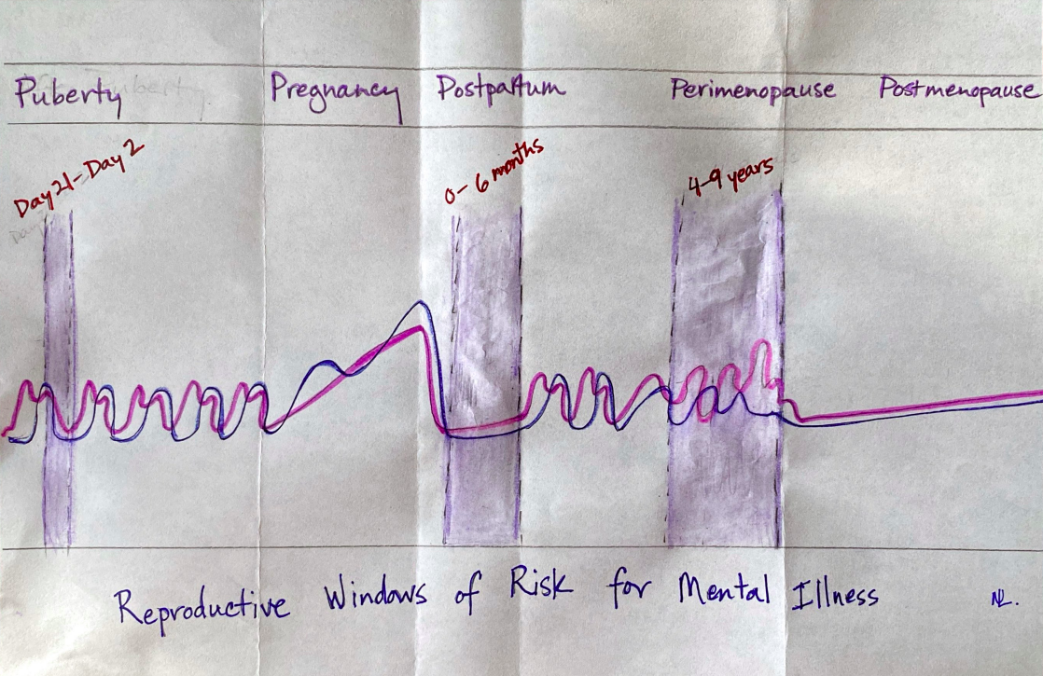

Slide 4
The Menstrual Cycle and the PMDD Hazard Zone (Day 21-Day 2)

Slide 5
What is PMS?
The International Society for Premenstrual Disorders and the Royal College of Obstetricians and Gynecologists define PMS as
1) Physical and or emotional symptoms
2) Symptoms are present during luteal phase and abate as menstruation begins
3) A symptom-free week
4) Symptoms are associated with significant impairment during luteal phase

Slide 6
What is PMDD?
DSM-V Criteria
A. In most menstrual cycles, following symptoms must be present in final week before onset of menses, start to improve within few days after onset of menses, and become minimal or absent in week postmenses–at least 1 symptom must be either (1), (2), (3), or (4) and individual must experience at least 5 total symptoms:
1. Marked affective lability (eg, mood swings; feeling suddenly sad or tearful or increased sensitivity to rejection)
2. Marked irritability or anger or increased interpersonal conflicts
3. Marked depressed mood, feelings of hopelessness, or self-deprecating thoughts
4. Marked anxiety, tension, feelings of being “keyed up,” or “on edge”
5. Decreased interest in usual activities (eg, work, school, friends, hobbies)
6. Subjective difficulty in concentration
7. Lethargy, easy fatigability, or marked lack of energy
8. Marked change in appetite, overeating, or specific food cravings
9. Hypersomnia or insomnia
10. A sense of being overwhelmed or out of control
11. Physical symptoms such as breast tenderness or swelling, joint or muscle pain, sensation of “bloating,” weight gain

Slide 7
What is PMDD?
B. Symptoms are associated with clinically significant distress or interference with work, school, usual social activities, or relationships
C. Disturbance is not merely exacerbation of symptoms of another disorder
D. Criterion A should be confirmed by prospective daily ratings during at least 2 symptomatic cycles (diagnosis may be made provisionally prior to this confirmation)
E. Symptoms are not due to direct physiological effects of substance (eg, drug of abuse, medication or other treatment) or another medical condition (eg, hyperthyroidism)

Slide 8
How Common are PMS & PMDD?
Fewer women have PMDD than have PMS and women with PMDD may have symptoms of PMS as well. PMS encompasses more physical symptoms.
Studies have been difficult to conduct because of recall bias with retrospective reporting. Of the few studies available, the prevalence of PMS in menstruating women is estimated at 20-30%.
PMDD is more severe and less common, has a prevalence estimated at 1.2%-6.4%

Slide 9
What Causes PMDD?
Research does NOT support different levels of hormones in women with PMDD, but instead supports different women’s differing vulnerability to normal hormonal fluctuations
There is considerable evidence that women with PMDD have a paradoxical response to allopregnanolone, the metabolite of progesterone that ordinarily has anxiolytic effects but seems to provoke the opposite in women with PMDD
There is also evidence for a malfunctioning of the serotonin transporter
There may also be a difference in brain circuitry, with differences in the frontal cortex that make it more difficult for women with PMS or PMDD to exert top-down control on emotions

Slide 10
How to Diagnose PMDD
Prospective Ratings for at least 2 menstrual cycles are key
Many women think they have PMDD, but on careful prospective rating it turns out that their symptoms are not cyclical, or that they are, but there are also symptoms present at a lower level at other times of the cycle
It’s important to characterize this carefully, as treatment will differ

Slide 11
How To Diagnose PMDD

Slide 12
How to Treat PMDD
Nonpharmacological approaches can be helpful. These include exercise, diet (a complex carbohydrate diet in the luteal phase was helpful in one randomized trial), and psychotherapy, particularly CBT.
SSRIs are first-line treatment, and there is strong evidence of their efficacy, at lower doses than used for anxiety/depression, and with possible benefit within 10 hours (likely working via a different mechanism than they do for depression)
Can be dosed continuously, or with luteal phase or symptom onset dosing. Some evidence indicates that continuous dosing may be slightly more effective, but we need more research.

Slide 13
Test Your Learning Questions
During which part of the menstrual cycle are women at risk for PMDD?
How common is PMS vs. PMDD?
What type of data tracking would support a diagnosis of PMDD?
What factors would exclude a diagnosis of PMDD?
What are first line treatments for PMDD?

Slide 14
Test Your Learning Answers
During which part of the menstrual cycle are women at risk for PMDD? During the Luteal Phase, Days 21- day 2
How common is PMS vs. PMDD? PMS =20-30% vs. PMDD=1-6%
What type of data tracking would support a diagnosis of PMDD? Prospective ratings of symptoms for at least 2 cycles
What factors would exclude a diagnosis of PMDD? Symptoms are not impairing, do not follow the luteal phase pattern, or are an exacerbation of another disorder.
What are first line treatments for PMDD? Exercise, diet, psychotherapy and low dose SSRIs during the luteal phase or started at symptom onset.

Slide 15
How to Deepen Your Learning in PMDD using NCRP Resources
6 minute video illustrating the Follicular Phase of the Menstrual Cycle
5 minute video illustrating the Luteal Phase of the Menstrual Cycle
Progressive Case Conference following a woman through conversations about contraception, premenstrual symptoms, and perimenopause.
Premenstrual Mood Syndromes module

Slide 17
What is Perimenopause?
Window of increased risk for new onset or recurrence of depression
4-8 year transition leading up to menopause during which hormonal fluctuations are frequent and unpredictable
The mean age of menopause (final menstrual period) in the US is 51
Clinical diagnosis: at least a 7-day difference in the length of 2 or more cycles in the last 10 months

Slide 18
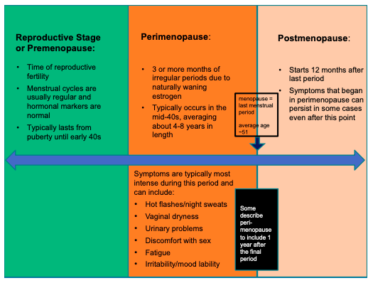
What is Perimenopause?

Slide 19
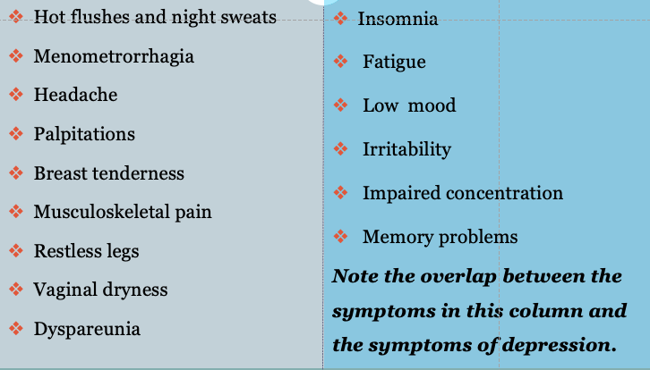
Symptoms of Perimenopause

Slide 20
Perimenopausal Depression
Common! 45-68% of women report depressive symptoms during perimenopause
Symptoms of perimenopause can mimic or exacerbate psychiatric illness
Mood changes, cognitive changes, sleep disturbance, and impaired sexual function can be caused by perimenopause, psychiatric illness, or both.
Important to do a full assessment and treat BOTH illness and perimenopausal symptoms

Slide 21
Questions to Elicit Perimenopausal Symptoms
Have you noticed any changes in the length or frequency of your periods?
Are you having any hot flashes or night sweats (vasomotor symptoms or VMS)?
Are you having trouble sleeping at night?
Are you having any trouble remembering things or concentrating?
Any issues with urination, vaginal dryness or discomfort with sex?
Any weight gain or joint pain?

Slide 22
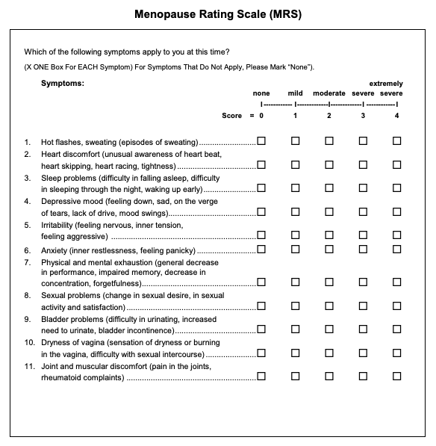
Perimenopausal Depression
Increased risk of exacerbation or new onset depression in perimenopause.
Symptoms of perimenopause can mimic or exacerbate psychiatric illness
Mood changes, cognitive changes, sleep disturbance, and impaired sexual function can be caused by perimenopause, psychiatric illness, or both.
Important to do a full assessment and treat both illness and perimenopausal symptoms

Slide 23
How to Treat Perimenopausal Depression
Treat the same as depression at other times, but use agents, if needed, that also work for VMS or other symptoms:
SSRIs: citalopram, escitalopram, fluoxetine, paroxetine
SNRIs (also work for chronic pain): duloxetine and venlafaxine or desvenlafaxine
Other: mirtazapine and vortioxetine
Investigate and treat remaining perimenopausal symptoms. This can be complicated!
Refer when needed for further workup.

Slide 24
How to Treat Perimenopausal Depression – what about MHT?
Menopausal Hormone Therapy (MHT) can be an important adjunct – it’s the gold standard for VMS and may have an impact on mood but…it’s complicated.
Some studies have found estrogen to be beneficial in treating depression, but it needs to be given with progesterone in women with a uterus to reduce the risk of endometrial cancer and we don’t have data yet to support the efficacy of this combination.
There are also safety concerns but MHT can be an option for women within 10 years of menopause or under 60 without contraindications.
Check out the NCRP module: Symptoms of Perimenopause and Menopausal Hormone Therapy

Slide 25
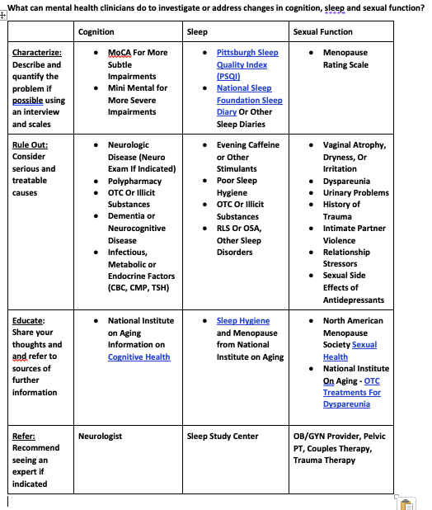

Slide 26
Test Your Learning Questions
What is perimenopause, how long does it last, and why is it clinically significant?
How is perimenopause diagnosed?
What are typical symptoms of perimenopause?
What are first line treatments for perimenopausal depression?
Why is it important to screen for and treat other perimenopausal symptoms in addition to treating depression?

Slide 27
Test Your Learning Answers
What is perimenopause, how long does it last, and why is it clinically significant? Perimenopause is the time leading up to menopause (12 months with no period), typically 4-8 years, when hormones fluctuate and periods are irregular. It is a window of risk for new onset or exacerbation of depression.
How is perimenopause diagnosed? Through clinical interview based on 2 or more periods in 10 months fluctuating by at least 7 days.

Slide 28
Test Your Learning Answers
What are typical symptoms of perimenopause? VMS, sleep disturbance, cognitive complaints, urinary problems, vaginal dryness or discomfort, weight gain and joint pain.
What are first line treatments for perimenopausal depression? SSRIs and SNRIs that also work for VMS, plus mirtazapine and vortioxetine
Why is it important to screen for and treat other perimenopausal symptoms in addition to treating depression? Other symptoms may mimic, worsen or prolong depression, treating the whole patient is likely to be more successful!

Slide 29
How to Deepen Your Learning in Perimenopause using NCRP Resources
Visit the NCRP Perimenopause Module containing:
Epidemiology of Psychiatric Illness During Perimenopause
Symptoms of Perimenopause and Menopausal Hormone Therapy
Alternative Treatments for Vasomotor Symptoms
Putting it all Together
A Progressive Case Conference with 3 Videos of a Sample Patient Interview
A Media Module on “Bioidentical” Hormones

