Slide 1
Trauma Management in the Perinatal Period

Slide 2
Learning Objectives
Identify and screen for trauma
Understand basic principles of Trauma Informed Care
Discuss evidence based treatments for PTSD
Compare and contrast various therapy modalities recommended for trauma management
Review medication management options for PTSD
Identify available resources for further learning

Slide 3
Part 1 of Case
Initial Presentation

Slide 4
Chief Complaint + HPI
Chief Complaint: referral from PCP for low mood in postpartum period
History of Present Illness:
Catori is a 37 year old married, employed Native American female being seen for an intake. She has been referred to psychiatry for assessment in context of her low mood after giving birth two months ago.
Pregnancy: While it was unplanned, both she and her husband desired the pregnancy. She describes having a rough pregnancy with a lot of initial nausea and vomiting followed by a 70 lb weight gain. The pregnancy strained her marriage, and some body image issues had resurfaced for Catori.

Slide 5
HPI (cont.)
Delivery: Though initially reluctant to discuss her experience of labor and delivery, she eventually described a significant complication that was traumatic for her. Labor stopped progressing, and she had to undergo a C-Section for which she was unprepared. When the he possibility had been raised earlier she had refused as she was worried about needing pain medication after. Per Catori, the scar split open after her C-Section and the wound got infected. She was afraid to go on pain medication due to her history of opioid use disorder with multiple years of sobriety and opted to stay on NSAIDS. This resulted in a prolonged recovery as well as pain with moving. Meanwhile the baby was in the ICU for “some breathing issue.” She discusses being “terrified” and feeling like a failure. Says “if I weren’t so fat, none of this would have happened and my baby would have been fine.”

Slide 6
HPI (cont.)
Postpartum: The baby is currently 2 months old and may have residual deficits and possible Cerebral Palsy. Catori is trying to go back to work for financial reasons, but she is having difficulty concentrating. She is unable to stay at work the whole day, worrying something might have happened to her baby. Her manager has been flexible finding her things she can do from home, but Catori worries this support will not last long. She finds it difficult to be at her desk as she feels “jumpy”, noting that when co-workers put a hand on her chair she starts “freaking out”, becoming overwhelmed with a sense of dread and panic. She reports intrusive thoughts about the day of the birth, noting “most moms love to tell their birth story, but I cry when someone asks about it.” She reports she doesn’t feel like herself anymore. She finds it hard to do dressing changes on her wound, which is still healing. She reports feeling her emotions are more numbed. She also reports feeling restless and tense.
She has had her mother-in-law move in to the house to help with the kids and housework. She alludes to increased tension between herself and her husband but is quite reluctant to discuss details when probed.

Slide 7
Mental Status Exam
Adult Native American women, obese, with good hygiene and casual attire.
Makes fair eye contact, is tearful at times, with mild psychomotor slowing.
No tics, tremors, or other abnormal movements noted.
Mood is “not good”. Affect is congruent, dysthymic, reactive with a restricted range.
Speech is somewhat monotonous with normal rate/volume/prosody.
Thought process is logical, linear, and goal-directed.
There is no evident suicidal or homicidal ideation, intent, or plan. No evidence delusions, obsessions, or compulsions.
Does not appear to be responding to internal stimuli.
Alert and fully oriented, with normal recent and remote memory, attention, and concentration as per responses to interview.
Insight and judgment are fair.
Gait is normal.

Slide 8
Discussion
What is your differential diagnosis?
What additional information would you like?

Slide 9
Past Psych Hx
Suicide attempt: Age 24 via overdose describes it as “I wanted to escape I’m not sure I wanted to die”
Hospitalizations: 2 admissions to inpatient rehab
Medications: Has been on Methadone in the past. She was also tried on Wellbutrin- “I think it worked”, unsure why this was discontinued
Therapy: Substance use groups in the past, none for several years

Slide 10
Family Hx
Diagnosis: positive for depression, anxiety on both sides of the family. Reports her mom has finally started seeking help from the services available on the reservation and has been diagnosed with MDD. Mother is currently on fluoxetine.
Suicide: Maternal Uncle died by suicide. Two cousins died by overdose- she thinks these were intentional.
Substance Use: Describes significant alcohol and marijuana use on both sides of the family in immediate and extended family members. Her father had a severe alcohol use disorder and died from liver cirrhosis.

Slide 11
Substance Use Hx
Started at age of 14 with THC and alcohol. Denies any history of heavy marijuana or alcohol use.
Identifies heroin as her substance of choice- Started using heroin at age 16, last use age 25. Initially with intranasal use, then used IV heroin (up to 8 bags/day). Reports medication, individual and group therapy combo was vital in staying remaining abstinent.
Continues to attend NA groups when she can.
No tobacco or any other substance use at this time.
Caffeine: 3 cups of coffee and 2 cans of soda daily.

Slide 12
PMHx
Medical History:
BMI 32
PCOS
Hx of concussion and broken ribs at the age of 20 (assaulted by boyfriend)
Denies hx of seizures
Currently breastfeeding
Labs:
CBC, CMP are WNL
TSH status unknown
Vitamin D level 25.3
OBGYN:
Two normal vaginal deliveries, 1 C-section
Contraception : Her initial plan had been an IUD for birth control however, the idea of having another procedure albeit a minor one has been terrifying to her. No current contraception.
Allergies: Sulfa Medications

Slide 13
Social Hx
She works a desk job.
Her husband is a bouncer at a strip club.
They have three daughters: ages 9 and 6 years old and 2 months old
There are no guns at home.
She graduated from high school.
She has filed a restraining order against an ex-boyfriend who assaulted her at age 20.
Patient has no past/current legal charges and no history of incarceration/involvement with legal system otherwise.

Slide 14
Discussion
What are Catori’s identifiable risk factors for her primary diagnosis?
What would you propose as a treatment plan? (Consider all aspects of the biopsychosocial model.)

Slide 15
Burden of Trauma
About half of all women in the US will be exposed to at least one traumatic event in their lifetime. (1)
Research indicates that women are more vulnerable to sexual assault and childhood sexual abuse than men. (2)
Per CDC National Intimate Partner and Sexual Violence Survey conducted in 2010 1 in 5 women (18.3%) in the US have been raped at some point in their lives. (3)
Notes:
Mitchell, K. S., Mazzeo, S. E., Schlesinger, M. R., Brewerton, T. D., & Smith, B. N. (2012). Comorbidity of partial and subthreshold PTSD among men and women with eating disorders in the National Comorbidity Survey-Replication Study. International Journal of Eating
Tolin, D. F., & Foa, E. B. (2006). Sex differences in trauma and posttraumatic stress disorder: A quantitative review of 25 years of research. Psychological Bulletin, 132, 959-992. doi: 10.1037/0033-2909.132.6.959
Black, M. C., Basile, K. C., Breiding, M. J., Smith, S. G., Walters, M. L., Merrick, M. T., Chen, J., & Stevens, M. R. (2011). The National Intimate Partner and Sexual Violence Survey (NISVS): 2010 Summary Report. Atlanta, GA: National Center for Injury Prevention and Control, Centers for Disease Control and Prevention

Slide 16
Burden of Trauma
Birth Trauma
As many as 1/3 of women rate their delivery as significantly distressing
Significant minority met criteria for postpartum-PTSD (PP-PTSD) (acute PP-PTSD 4.6-6.3%)
Reproductive Loss and Posttraumatic Stress Disorder
In USA, 16% of pregnancies end in spontaneous abortion (SAB) or stillbirth
About 19% of pregnancies end in elective abortion (EAB)
12-32% of SABs and EABs can lead to PTSD (Hamana, 2010)

Slide 17
Risk of PTSD
Women are twice as likely as men to develop PTSD after a traumatic event and to carry this diagnosis across their lifetime (12% women vs. 6% men) Kessler, Sonnega, Bromet, Hughes, & Nelson, 1995
Approximately 8% of women have PTSD in pregnancy or postpartum, and fewer (3%) develop new onset of PTSD after a traumatic childbirth (Ross & McLean, 2006).
Finally, a history of childhood abuse also increases the risk of perinatal PTSD, in part, through a heightened likelihood of engaging in abusive or unsupportive relationships (Smith, Poschman,
Cavaleri, Howell, & Yonkers, 2006).

Slide 18
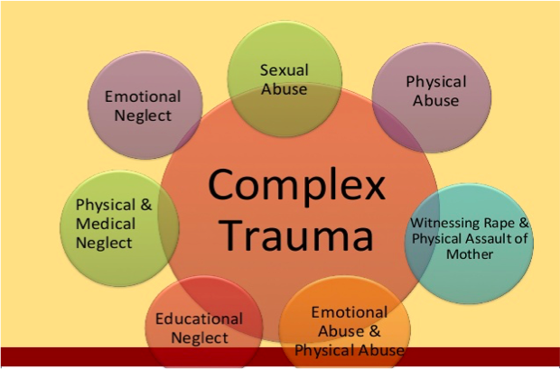

Slide 19
Dissociation
DSM 5 includes dissociative subtype (complex PTSD) in its diagnostic criteria
Can result from severe childhood maltreatment/sexual abuse
Dissociation could increase risk for abuse/neglect of her children.

Slide 20
Trauma Informed Care
Organizational structure and treatment framework
Involves understanding, recognizing, and responding to the effects of of trauma
Emphasizes physical, psychological, and emotional safety for both consumers and providers
Helps survivors rebuild a sense of control and empowerment.
http://www.traumainformedcareproject.org/

Slide 21
Core Principles of TIC
Safety – ensuring physical and emotional safety
Trustworthiness – maintaining appropriate boundaries and making tasks clear
Choice – prioritizing (staff) consumer choice and control (people want choices and options; for people who have had control taken away, having small choices makes a big difference)
Collaboration – maximizing collaboration
Empowerment – prioritizing (staff) consumer empowerment and skill-building
Notes:
Trauma Informed Care (TIC) is a holistic, person-centered approach to treatment that understands and incorporates the biological, psychological, neurological, and social impact of trauma on an individual.

Slide 22
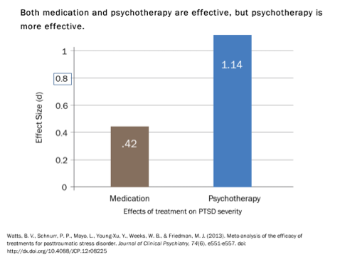
How can PTSD be treated

Slide 23
Psychotherapy vs. Pharmacotherapy
A meta analysis of treatments for PTSD suggests that psychotherapy is more effective than medications. (1)
There have been few head to head comparisons of trauma focused psychotherapy and a first line medication for treating PTSD, two recent meta analysis compared the treatment effects of psychotherapies and pharmacotherapies. (1,2)
The results showed that trauma focused psychotherapies lead to greater improvements than medications, and that these improvements lasted longer.
Watts, B. V., Schnurr, P. P., Mayo, L., et al. (2013). Meta-analysis of the efficacy of treatments for posttraumatic stress disorder. Journal of Clinical Psychiatry, 74, e541-550. doi:10.4088/JCP.12r08225
Lee, D. J., Schnitzlein, C. W., Wolf, J. P., Vythilingam, M., Rasmusson, A. M., & Hoge, C. W. (2016). Psychotherapy versus pharmacotherapy for posttraumatic stress disorder: Systematic review and meta-analyses to determine first-line treatments. Depression and Anxiety, 33, 792-806. doi:10.1002/da.22511

Slide 24
Part 2 of Case
3 months later

Slide 25
Case continued...
Catori returns to you now 5 months postpartum. In the last 3 months she has been started on an SSRI and you have helped with getting approved medical leave as well as using local resources (MomBabyCare, a free service where an RN visits the home to help with teaching basic baby care) As per your initial plan, the goal was to stabilize her using medications to get her to the point of being able engage in some form of therapy.
Catori shares more about her personal life this visit. She grew up on the Navajo reservation in abject poverty and describes a childhood exposed to addiction, suicide, mental illness, and sexual violence. She has three brothers and four sisters; most of them continue to live on the reservation. She has left the reservation and lives in a city one hour away from it. She felt she needed to leave as she couldn’t succeed with gaining sobriety while at the reservation but notes that this was a difficult decision. She has a good relationship with her mom and feels her mom “did the best she could” with being protective of her. Her father died from cirrhosis. She remembers him as “an angry drunk”.

Slide 26
Case Continued ...
She describes a long history of being sexually abused by her uncle. In her childhood, he would come into her room at night when he was intoxicated and rape her, telling her he would kill her if she ever told anyone. She also had a series of physically and sexually abusive relationships as a teen and young adult.
Her husband is Caucasian. They met 10 years ago and got married within a year of meeting. She is currently dependent on him financially. She states that “he has a temper”. She describes one incident where he got very upset and she felt reminded of her previous boyfriends. This occurred a few weeks before her second visit, and since then she has noticed she has episodes of hyperventilation, sweating, heart racing and chest pressure. She thinks something maybe wrong with her heart. She often wakes up in the middle of the night after a horrific dream and experiences the symptoms described above.

Slide 27
Discussion
How would you go about discussing intimate partner violence (IPV) with the patient?
How do you incorporate your suspicion of IPV into your treatment plan?
What are different therapy modalities you would consider for this patient?
What medication options are there for her current panic attacks and nightmares?

Slide 28
Evidence Based Psychotherapy Treatments
Cognitive Behavioral Therapy (CBT)
Prolonged Exposure (PE)
Cognitive Processing Therapy (CPT)
Eye Movement Desensitization and Reprocessing (EMDR)
Stress Inoculation Training (SIT)
Notes:
*more information presented on PE, CPT, and EMDR in later slides*
Cognitive behavioral therapies or CBT combine building new cognitive skills and engaging in new behaviors or changing existing ones. Numerous randomized, controlled studies on cognitive behavioral therapies for PTSD demonstrate that treatment works. Two of the most consistently proven types of CBT are Prolonged Exposure therapy and Cognitive Processing Therapy.
It is important to be able to describe the most effective cognitive behavioral therapies to trauma survivors so that you can help them understand what these treatments are and encourage them to seek treatment.

Slide 29
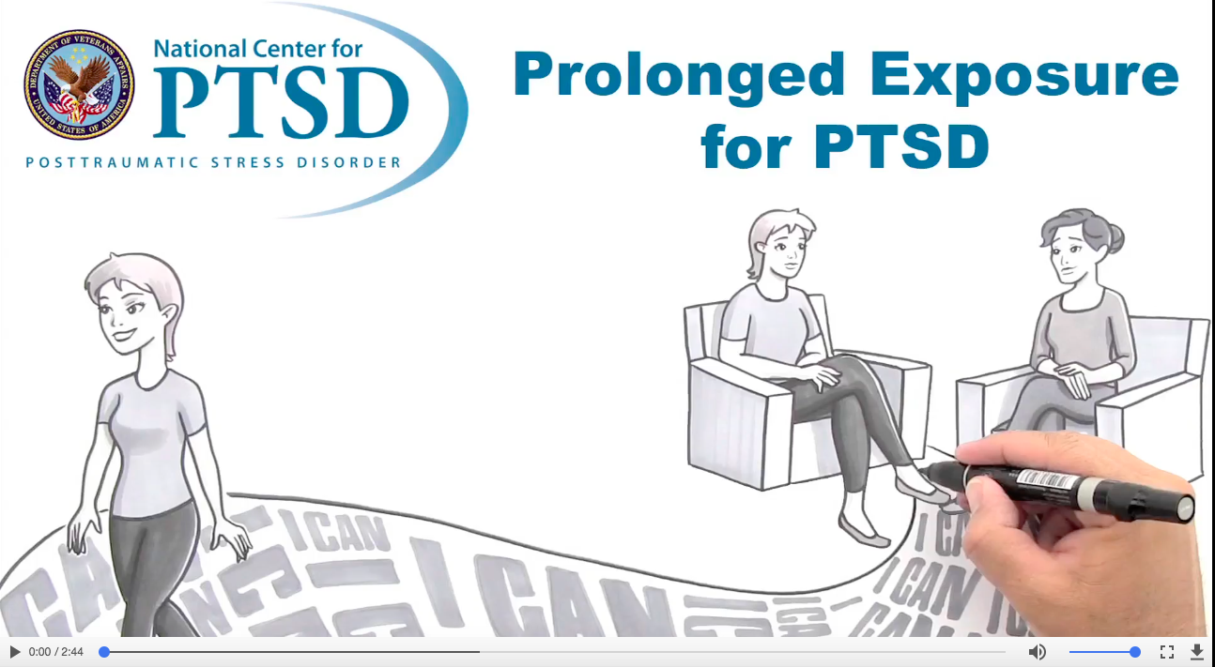
What is Prolonged Exposure?
https://www.media.eo.va.gov/ptsd/mp4/Whiteboard_PE.mp4
Notes:
It’s based on cognitive-behavioral principles that are grounded, strongly, in emotional processing theory. There is a large body of empirical support. Lots of research has been done on Prolonged Exposure with very complex, difficult, patients; all types of patient populations.
The sessions are 90 minutes and individual. Generally, there’s between 8 and 15 sessions with an average of 10 sessions per patient. It’s a structured and manualized treatment with flexibility and strong emphasis on collaboration and the therapeutic relationship.
A meta analysis conducted by Powers in 2010 showed that Prolonged Exposure has a large effect size on Posttraumatic Stress Disorder symptoms. It also has large effect size on general distress outcomes that include things like depression, or anxiety, or other things.
In general, an average PE patient fared better than 86% of patients in control conditions, including supportive therapy or other unstructured talk therapies, so PE is very effective in related to significant life changing differences.

Slide 30
Prolonged Exposure
Teaches individuals to approach their trauma related memories, feelings, and situations.
The aim is to learn that the trauma related memories and cues are not dangerous and do not need to be avoided.
Both Imaginal and In vivo exposure is utilized, with the pace determined by the patient
Notes:
Prolonged exposure is typically provided over a period of about three months with weekly individual sessions, resulting in eight to 15 sessions overall. The original intervention protocol was described as nine to 12 sessions, each 90 minutes in length (Foa & Rothbaum, 1998)
Imaginal exposure occurs in session with the patient describing the event in detail in the present tense with guidance from the therapist. Together, patient and therapist discuss and process the emotion raised by the imaginal exposure in session. The patient is recorded while describing the event so that she or he can listen to the recording between sessions, further process the emotions and practice the breathing techniques.
In vivo exposure, that is confronting feared stimuli outside of therapy, is assigned as homework. The therapist and patient together identify a range of possible stimuli and situations connected to the traumatic fear, such as specific places or people. They agree on which stimuli to confront as part of in vivo exposure and devise a plan to do so between sessions. The patient is encouraged to challenge him or herself but to do so in a graduated fashion so as to experience some success in confronting feared stimuli and coping with the associated emotion.

Slide 31
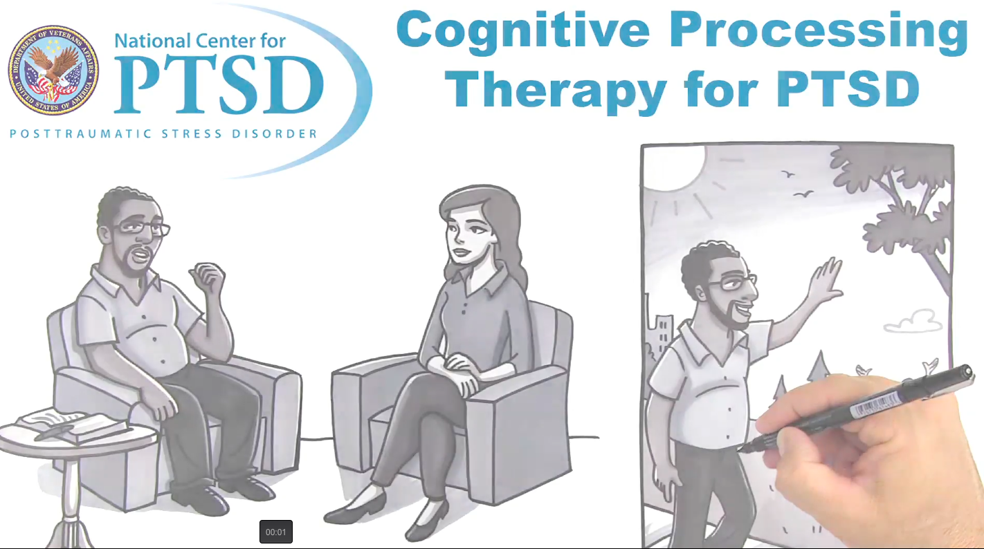
CPT for PTSD
https://www.ptsd.va.gov/public/materials/videos/index.asp#

Slide 32
Cognitive Processing Therapy
One of the most well-researched cognitive approaches
Focus on challenging/modifying maladaptive beliefs related to trauma
Has a written exposure component
12 session protocol
Can be conducted both in individual and group settings.
Notes:
Treatment begins with psychoeducation regarding PTSD, thoughts, and emotions. The patient becomes more aware of the relationship between thoughts and emotions and begins to identify “automatic thoughts” that may be maintaining the PTSD symptoms. The patient writes an impact statement that details current understanding of why the traumatic event occurred and the impact it has had on beliefs about self, others, and the world.
Next, the patient begins more formal processing of the trauma. The patient writes a detailed account of the worst traumatic experience, which the patient reads in the next session to try and break the pattern of avoiding thoughts and feelings associated with the trauma. The therapist uses Socratic questioning and other strategies to help the patient question his or her unhelpful thoughts about the trauma (e.g., self-blaming thoughts) in order to modify any maladaptive thinking.
Finally, once the patient has developed skills to identify and address unhelpful thinking, she or he uses those skills to continue evaluating and modifying beliefs related to traumatic events. At this point, the therapist is helping the patient develop the ability to use these adaptive strategies outside of treatment to improve overall functioning and quality of life. Therapists may particularly focus on safety, trust, power, control, esteem and intimacy as these are all areas that can be affected by traumatic experiences.
Resick, P.A., & Schnicke, M. K. (1996). Cognitive Processing Therapy for rape victims: A treatment manual. Newbury Park, CA: Sage Publications.

Slide 33
What is EMDR
https://www.media.eo.va.gov/PTSD/mp4/VA_Video01_EMDR_VFinal_NoAudioDescribe.mp4

Slide 34
EMDR
Eye Movement Desensitization and Reprocessing Therapy was initially introduced in 1989 by Dr. Shapiro.The objective of EMDR is to assist patients to access, and process, traumatic memories while bringing them to an adaptive resolution.
It is a manualized therapy that is divided into 8 stages/steps
Obtaining a patient history and treatment planning.
Prepare the client to participate in the treatment.
Assessment.
Desensitization and reprocessing.
Installation of a positive cognition.
Body scan.
Closure for the procedure
Ongoing reevaluation of patient status.
Notes:
EMDR first came on the scene in 1989 when Dr. Francine Shapiro, the developer of the EMDR, started to publish some of the first work. The objective of EMDR is to assist patients to access, and process, traumatic memories while bringing them to an adaptive resolution. And, similar to some other theories of PTSD and some other treatments, the notion is that, if distressing memories remain unprocessed, they become the basis of current dysfunctional reactions and maintain problems overtime. And, the suggestion is that EMDR itself, particularly through the use of the eye movements or other dual attention stimuli, facilitate the kind of emotional processing that is needed to resolve the traumatic memories.
As the image of the trauma, and the memory of the trauma, becomes less salient with this process, clients are thought to be able to better access, and attend to, more adaptive information and forge new connections in their memory networks to change how the memory is represented. The concept is that these procedures both increase the accessibility of the trauma memories and also improve the ability to process the memories in new ways.
It is a manualized therapy that is divided into a series of steps or 8 stages
Obtaining a patient history and treatment planning. 2. Prepare the client to participate in the treatment.3.Assessment. 4 . Desensitization and reprocessing. 5. Installation of a positive cognition. 6 Body scan. 7 Closure for the procedure 8 Ongoing reevaluation of patient status.
Now, one of the most novel things about EMDR, of course, is its inclusion of these eye movements. And, there has been some research on eye movements, both in conjunction as part of EMDR, and also in terms of their impact on emotional experience more generally. And, there are a number of different kinds of theoretical ideas about why eye movements might be useful, in some way, and might have an impact on emotional experiences.
They all have to do with ideas about cognitive processes, the working memory model, reassurance reflex model and orienting response theory. And, in fact, numerous lab studies do show that horizontal eye movements are associated with a decrease in the vividness, the emotionality and the levels of arousal associated with memories. And, there are some suggestion that eye movements may also increase the retrieval of memories and attentional flexibility. But, most of the studies on the function of eye movements on emotion are using normal participants in laboratory studies, not individuals with clinically significant disorder or PTSD.

Slide 35
CPT vs. PE vs. EMDR
All have been shown to be effective in outcome literature.
In 2002 a head to head comparison CPT vs PE was done for PTSD and depression in female sexual assault survivors. (1) Two studies compared EMDR to PE (2,3) one found equivalent results (2) and the other found PE to be superior.
So far, there is no clear winner.
Currently recommend a patient centered approach and shared decision making in choosing amongst available treatment options.
Notes:
Resick, P. A., Nishith, P., Weaver, T. L., Astin, M. C., & Feuer, C. A. (2002). A comparison of Cognitive Processing Therapy with Prolonged Exposure and a waiting condition for the treatment of chronic posttraumatic stress disorder in female rape victims. Journal of Consulting and Clinical Psychology, 70, 867-879. doi:10.1037/0022-006X.70.4.867
Rothbaum, B. O., Astin, M. C., & Marstellar, F. (2005). Prolonged Exposure versus Eye Movement Desensitization and Reprocessing (EMDR) for PTSD rape victims. Journal of Traumatic Stress, 18, 607-616. doi:10.1002/jts.20069
Taylor, S., Thordarson, D. S., Maxfield, L., Fedoroff, I.C., Lovell, K., & Ogrodniczuk, J.S. (2003). Comparative efficacy, speed, and adverse effects of three PTSD treatments: Exposure therapy, EMDR, and relaxation training. Journal of Consulting and Clinical Psychology, 71, 330-338. doi:10.1037/0022-006X.71.2.330

Slide 36
Stress Inoculation Training
Focus on management of anxiety and coping skills training
Tool Box:
Relaxation Training
Breathing Retraining
Positive Thinking and Self-Talk (practiced in homework)
Assertiveness Training
Goal is to give patient tools that they can use in all different kinds of anxiety eliciting situations.
Notes:
Stress Inoculation Training was developed, originally, by Donald Meichenbaum for anxiety disorders, and it was used a great deal in the treatment of anxiety, but then gradually was modified for rape victims in PTSD, as it was recognized that it might be efficacious for PTSD as well as other kinds of anxiety problems. And, although technically Stress Inoculation Training is distinct from trauma-focused interventions, it should be noticed that SIT includes some components, like cognitive restructuring or in vivo exposure, that are, in fact, included in some of the trauma focused interventions.
Although the trauma-focused interventions would look at cognitions and exposure to situations that were directly trauma related, whereas that it might not be so much the case in Stress Inoculation Training. Some Stress Inoculation Training techniques, such as breathing retraining, for example, are incorporated, as well, into the trauma-focused psychotherapies. PE or Prolonged Exposure includes a breathing retraining component. So, it can be a little bit difficult, sometimes, to separate out what these treatments are doing since they have some overlapping elements.
Stress Inoculation Training approach to treatment actually incorporates anxiety management techniques which address all three of the major response systems in which we might see the effects of anxiety: the cognitive system, that is, it challenges self-talk and negative appraisals, the physiological system, by directly inducing a reduction in arousal or increase in relaxation, and the behavioral systems, by helping people, for example, deal with interpersonal conflict situations more effectively.
The goal here is to give the person tools that they can use across all different kinds of anxiety eliciting situations. That is, they can apply these skills, trans-situationally. And, in fact, anxiety, itself, rather than just being a source of distress now becomes a cue to employ the toolbox of SIT skills.
The Cochrane review meta analysis, a systematic analysis of the research literature, concluded that stress management protocols, like SIT, were, in fact, as effective as other types of efficacious interventions for PTSD, most notably, the trauma-focused cognitive behavioral therapy interventions like exposure therapy and cognitive therapy and EMDR.

Slide 37
Acceptance and Commitment Therapy
Time limited behaviorally based treatment
Overall goal to help patients engage in valued behavior despite difficult emotions thoughts or memories
Limited research in PTSD
ACT is transdiagnostic
Fundamental focus is on living
Notes:
A” for accept private events and the term private events refers to those things that happen of inside the skin: your thoughts, your feelings, memories, physical sensations, urges. All of those things are private events.
The “C” is for choose and commit to living consistently with your personal values. So, choosing the direction that you want to go that’s important to you and committing to making those changes and steps in that direction.
“T” for take action – so taking action then in those areas that matter to you, that are meaningful to you, that you committed to in the service of your values.

Slide 38
Evidence Based Pharmacological Treatments
•First line medications
Selective Serotonin Reuptake Inhibitors (SSRIs)
Serotonin-Norepinephrine Reuptake Inhibitors (SNRIs)
Prazosin

Slide 39
Propranolol
Controlled studies have not been conducted in pregnant women
May reduce perfusion of the placenta
Use only if potential benefits outweigh potential fetal risks
Some drug is found in mother’s breast milk
Due to high lipid solubility, propranolol is found in breast milk more than many other beta blockers

Slide 40
Prazosin
Class: Alpha 1 Adrenergic Blocker
Commonly Prescribed for (bold for FDA approved)
• Hypertension
• Nightmares associated with PTSD
• Blood circulation disorders
• Problems urinating due to enlarged prostate
• Passing of kidney stones

Slide 41
Prazosin
• Controlled studies have not been conducted in pregnant women
• Prazosin has been used alone or in combination with other hypotensive agents in severe hypertension of pregnancy, with no fetal or neonatal abnormalities reported
• Prazosin should be used during pregnancy only if the potential benefits justify the potential risks to the mother and fetus
Maternal Levels: The manufacturer reports that one mother was studied and excreted at most 3% of the dose into her breastmilk
Notes:
1. Schaefer C, Peters P, Miller RK, eds. Drugs during pregnancy and lactation. Treatment options and risk
assessment, 2nd ed. Amsterdam; Boston: Elsevier Academic Press. 2007:685.
2. Barbieri C, Caldara R, Ferrari C et al. Metabolic effects of prazosin. Clin Pharmacol Ther. 1980;27:313-6. PMID:
6102000
3. Barbieri C, Ferrari C, Borzio M et al. Metabolic effects of chronic prazosin treatment. Horm Metab Res.
1980;12:331-4. PMID: 6105121

Slide 42
Role of Benzodiazepines in PTSD management
The evidence is mounting on the harms associated with chronic benzodiazepine use in patients with PTSD. VA/Dod Practice guidelines from 2010 recommend against use of benzodiazepines in patients with PTSD.
There have been two placebo controlled randomized clinical trials of benzodiazepine for treating PTSD. Both trials had negative findings. In (1) Xanax had no benefit in alleviating PTSD symptoms and in (2) Klonopin had no benefit for the tx of PTSD related sleep symptoms
A meta analysis of 18 studies done in 2015 with over 5200 participants found benzodiazepines ineffective for PTSD treatment and noted that the risks associated with their use outweigh potential short term benefits .(3)
Notes:
Braun, P., Greenberg, D., Dasberg, H., et al. (1990). Core symptoms of posttraumatic stress disorder unimproved by alprazolam treatment. Journal of Clinical Psychiatry, 51, 236-238. Retrieved from http://www.psychiatrist.com/jcp/Pages/home.aspx
Cates, M. E., Bishop, M. H., Davis, L. L., et al. (2004). Clonazepam for treatment of sleep disturbances associated with combat-related posttraumatic stress disorder. Annals of Pharmacotherapy, 38, 1395-1399. doi:10.1345/aph.1E043
Guina, J., Rossetter, S. R., De, R. B., et al. (2015). Benzodiazepines for PTSD: A systematic review and meta-analysis. Journal of Psychiatric Practice, 21, 281-303. doi:10.1097/PRA.0000000000000091

Slide 43
Updated Tx Plan
Updated Treatment Plan:
Explain various therapy modalities to patient, patient opts to try EMDR
Propranolol 10mg BID PRN was also started
Continue Lexapro 10mg PO QAM
Follow up monthly and collaborate with therapist.

Slide 44
6 months later….
Catori has noted a reduction in PTSD symptoms and panic attacks since engaging in EMDR and taking Lexapro (escitalopram). Over the last 1-2 months she has no longer required PRN propranolol. She is no longer experiencing nightmares.
She has also been working on assertiveness in therapy and is better able to communicate with her husband. She has returned to work fulltime, relieving much of the financial strain on her family. Her daughter is coming up on her first birthday. While she doesn’t have cerebral palsy, she is still under routine monitoring for seizures.
Catori is planning to go to the reservation for a month as her mother has fallen quite ill. She is concerned about reemergence of symptoms when surrounded by the setting of her earlier trauma. She tried to find a therapist there but can’t get in on short notice. She is worried her symptoms may return if she is not engaged in therapy.

Slide 45
Discussion
How would you counsel the patient on symptom management?
What resources would you recommend while she is away?

Slide 46
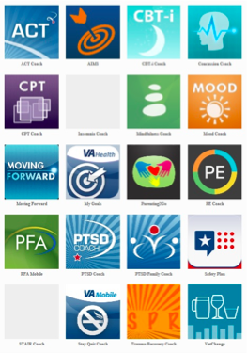
Mobile Apps
•NCPTSD has partnered with a number of organizations to develop a variety of mobile apps.
•Apps are focused on PTSD, related health problems (e.g., insomnia, alcohol use, etc.), or general well-being.
•There are apps for patients, providers, and for use with patient-provider dyads.
Source: NCPTSD

Slide 47
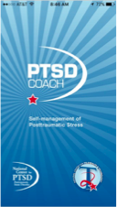
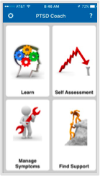
PTSD Coach
•PTSD Coach mobile app – more than 275,000 downloads in 98 countries.
•App provides:
–Education about PTSD and PTSD treatment
–A self-assessment tool
–Portable skills to address acute symptoms
–Direct connection to crisis support
•Used as stand-alone education and symptom management tool, or with face-to-face care.
Source: NCPTSD
Notes:
This app has now been downloaded over 100,000 times in 74 countries around the world. PTSD Coach is also available in 2 international versions: PTSD Coach Australia and PTSD Coach Canada. It can help patients learn about and manage symptoms that often occur after trauma. We are still awaiting the release of PTSD Coach in Spanish, and PTSD Family Coach.
Features include:
•Reliable information on PTSD and treatments that work
•Tools for screening and tracking your symptoms
•Convenient, easy-to-use tools to help you handle stress symptoms
•Direct links to support and help
•Always with you when you need it.

Slide 48
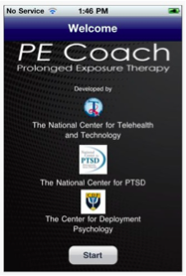
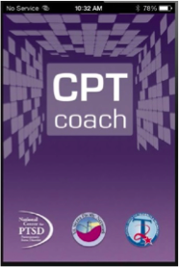
Treatment Companion Apps
Notes:
CPT Coach is a mobile app for patients to use with their therapists during face-to-face Cognitive Processing Therapy for PTSD. Features include:
•Education about CPT therapy.
•Ability to track your PTSD symptoms over time.
•Homework assignments and worksheets to work on between sessions.
•Tools to keep track of tasks you did between sessions.
•Reminders for therapy appointments.
PE Coach is a mobile app for patients to use with their therapists during Prolonged Exposure therapy for PTSD. Features include:
•Education about PE therapy and common reactions to trauma.
•Ability to record your PE therapy session as an audio file on your mobile device.
•Reminders to complete homework.
•Tools to keep track of tasks you did between sessions.
•Ability to track your PTSD symptoms over time.
•Guidance for breathing retraining - ways to change your breathing that help reduce your stress.

Slide 49
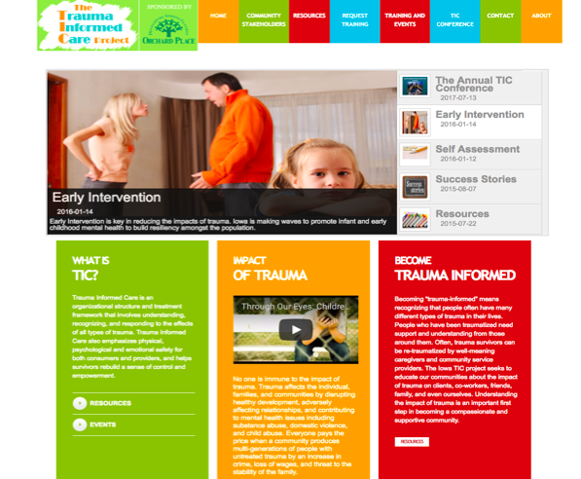

Slide 50
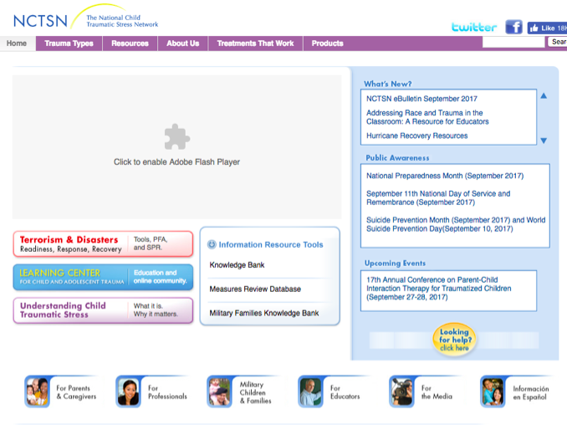

Slide 51
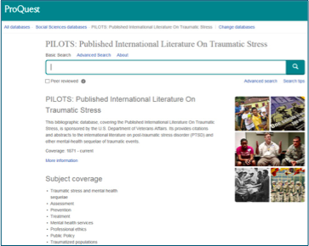
PILOTS Database
•The Published International Literature on Traumatic Stress (PILOTS) Database is an electronic index to the worldwide literature on trauma and PTSD.
•Currently, PILOTS has close to 55,000 searchable citations (e.g., articles, book chapters, dissertations).
Notes:
The Published International Literature on Traumatic Stress (PILOTS) Database is an electronic index to the worldwide literature on PTSD and other mental health consequences of exposure to traumatic events. Unlike other databases, the PILOTS Database does not restrict its coverage to articles appearing in selected journals. It attempts to include all publications relevant to PTSD and other forms of traumatic stress, whatever their origin without disciplinary, linguistic, or geographic limitations.
The PILOTS Database is produced by the National Center for PTSD, and is electronically available to the public. There is no charge for using the database, and no account or password is required. Although it is sponsored by the U.S. Department of Veterans Affairs, the PILOTS Database is not limited to literature on PTSD among Veterans.

Slide 52
Children and Parenting
Intergenerational patterns/epigenetic load
Offer parenting strategies to mother
Consider
Family therapy
Individual therapy for the child

